Slide 1
Chapter 23
Hormonal Regulation and Integration of Mammalian Metabolism

Slide 2
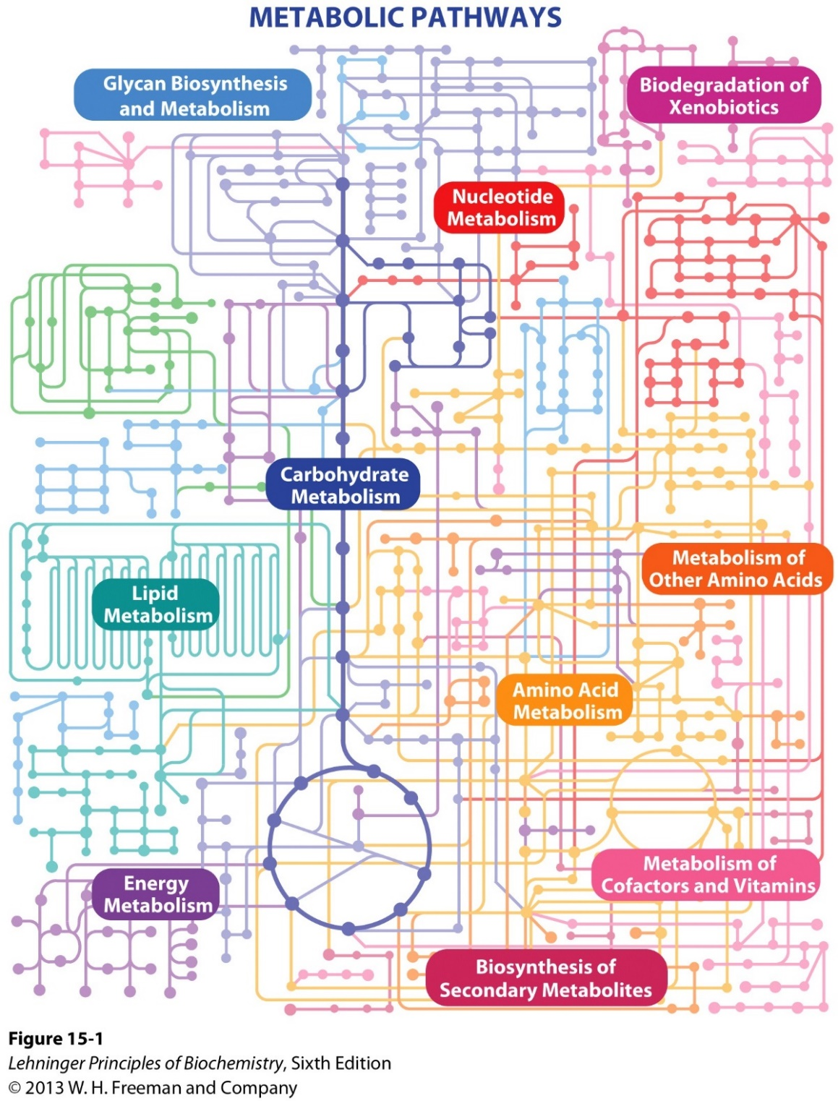
Metabolism as a
three-dimensional network
KEGG PATHWAY database:
http://www.genome.jp/kegg/pathway/map/map01100.html

Slide 3
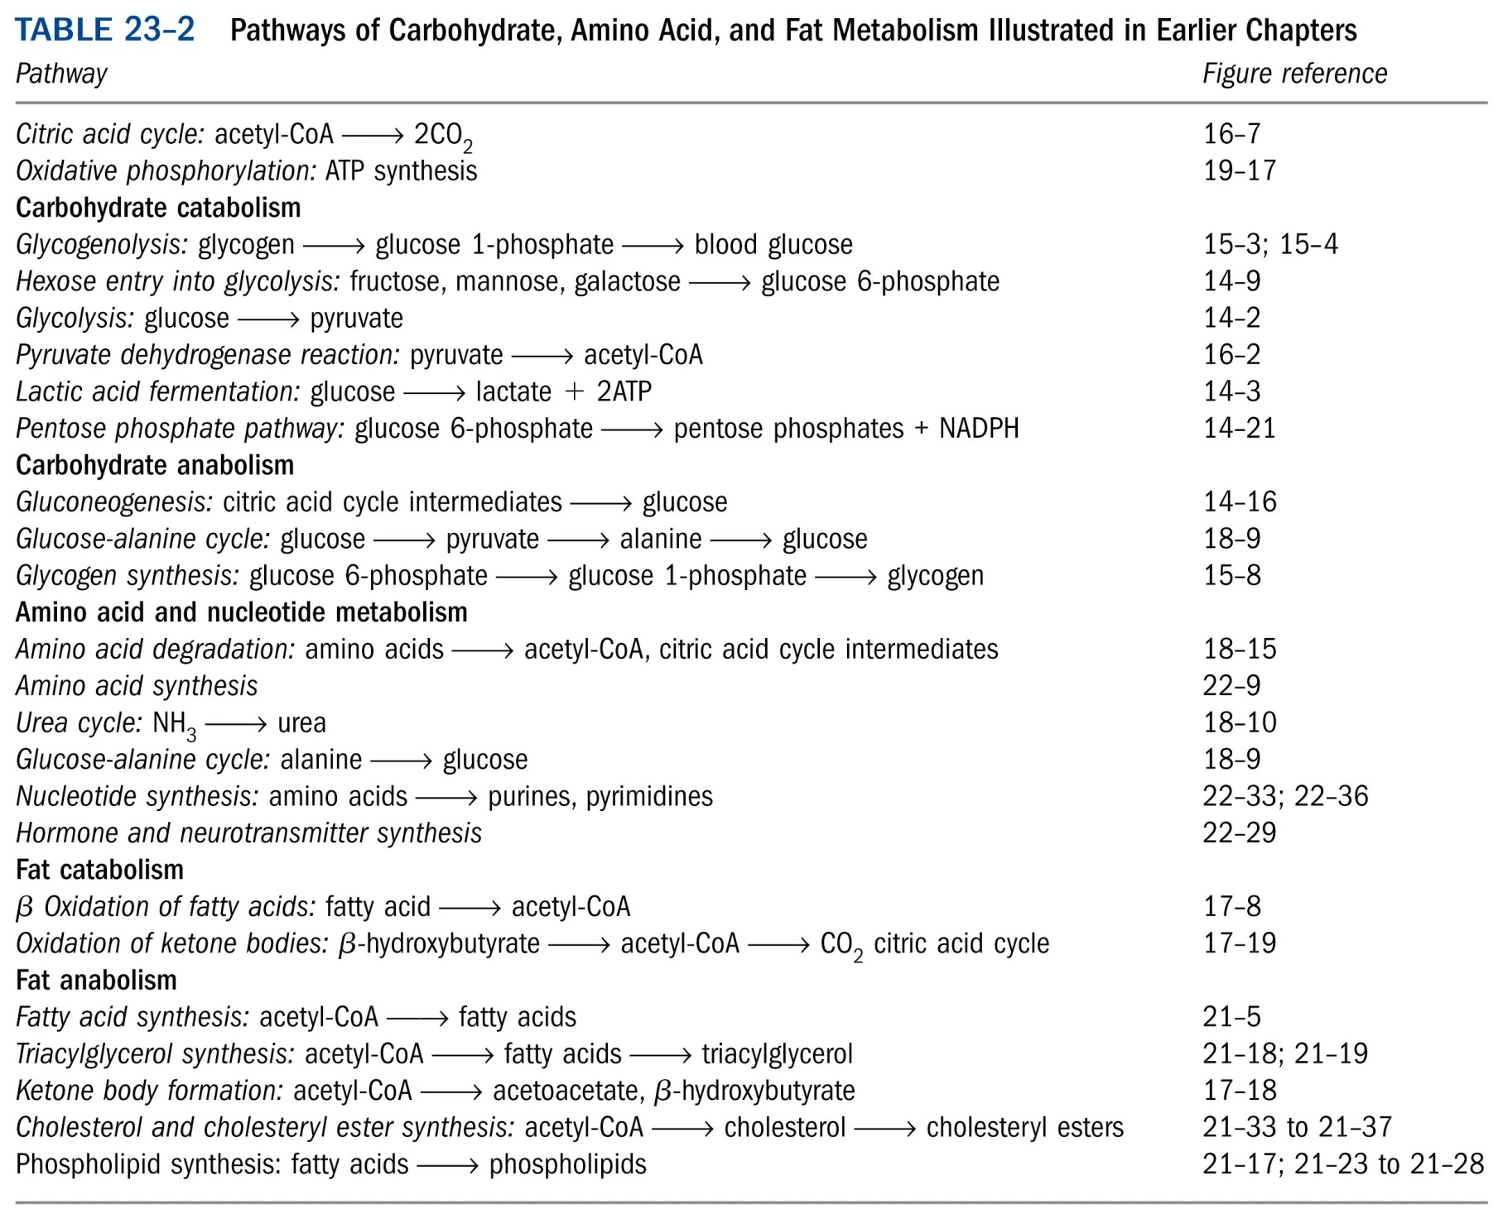
*****

Slide 4
Each tissue of the human body has a specialized function
Liver: processes and distributes nutrients
Adipose tissues: store and supply fatty acids
Skeletal muscle: generates ATP for motion
Brain: uses energy to transfer electrical impulses
Blood: mediates metabolic interactions among all tissues

Slide 5
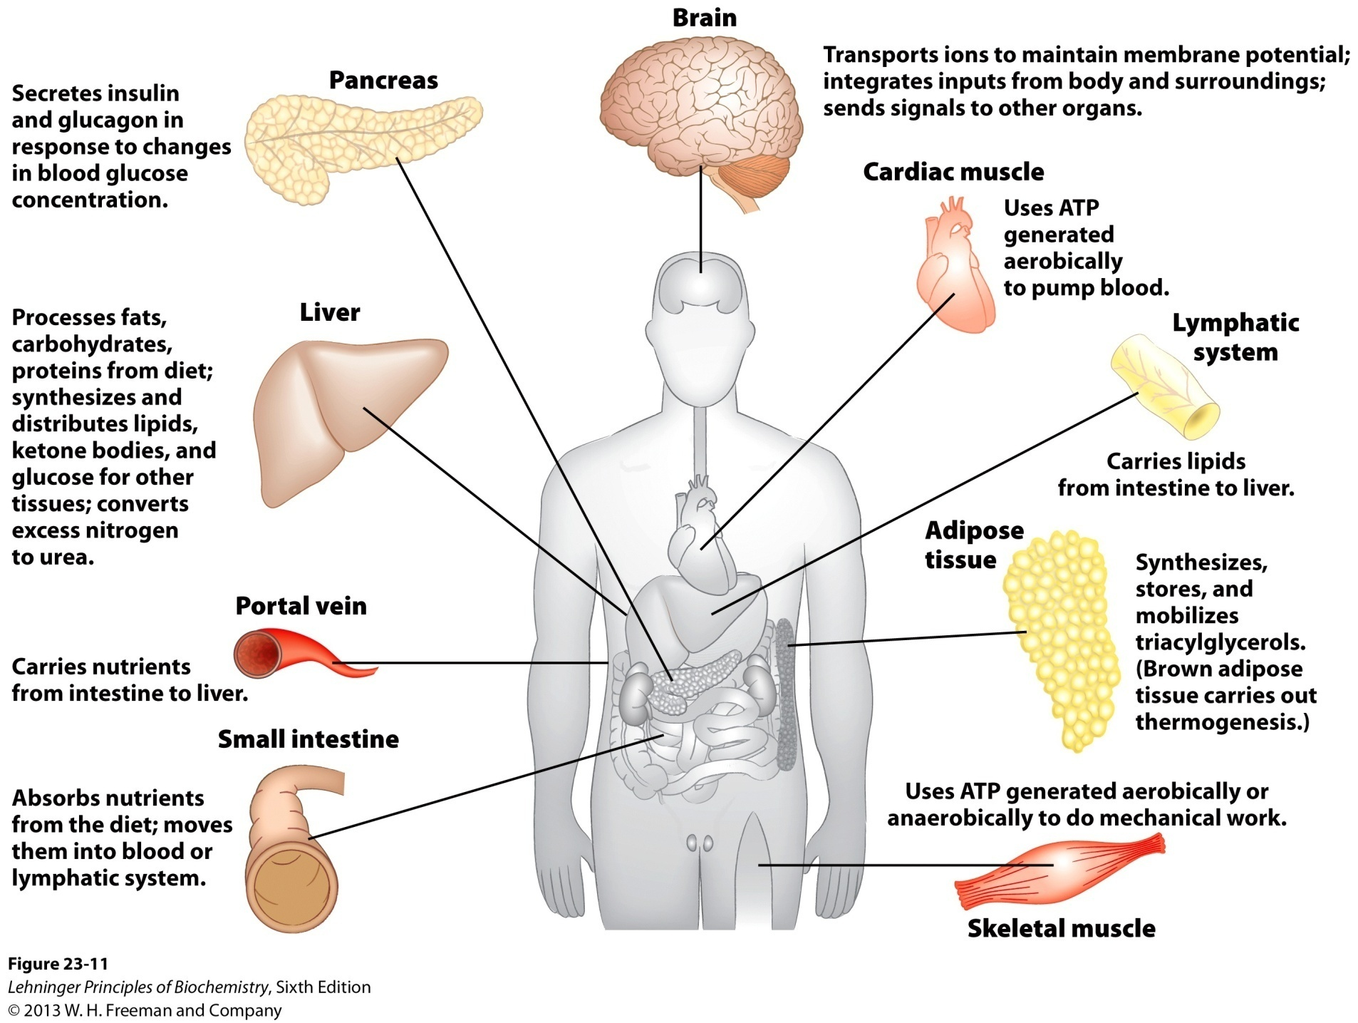
Specialized metabolic functions of mammalian tissues

Slide 6
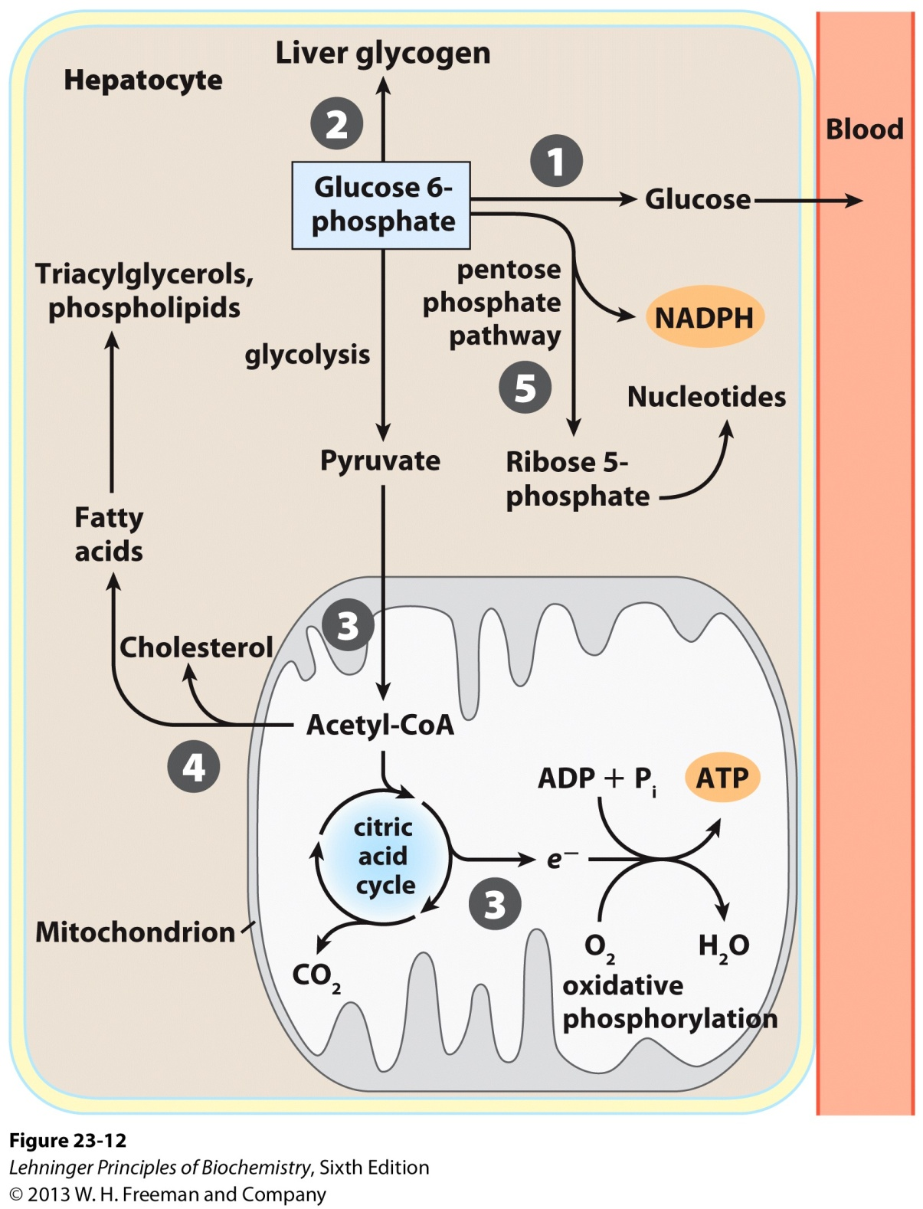
Exported to replenish
blood glucose
(exported)
Metabolic pathways
for glucose 6-phosphate
in the liver---5 different
metabolic routes
Glucose 6-phosphate is the key intermediate
in carbohydrate metabolism

Slide 7
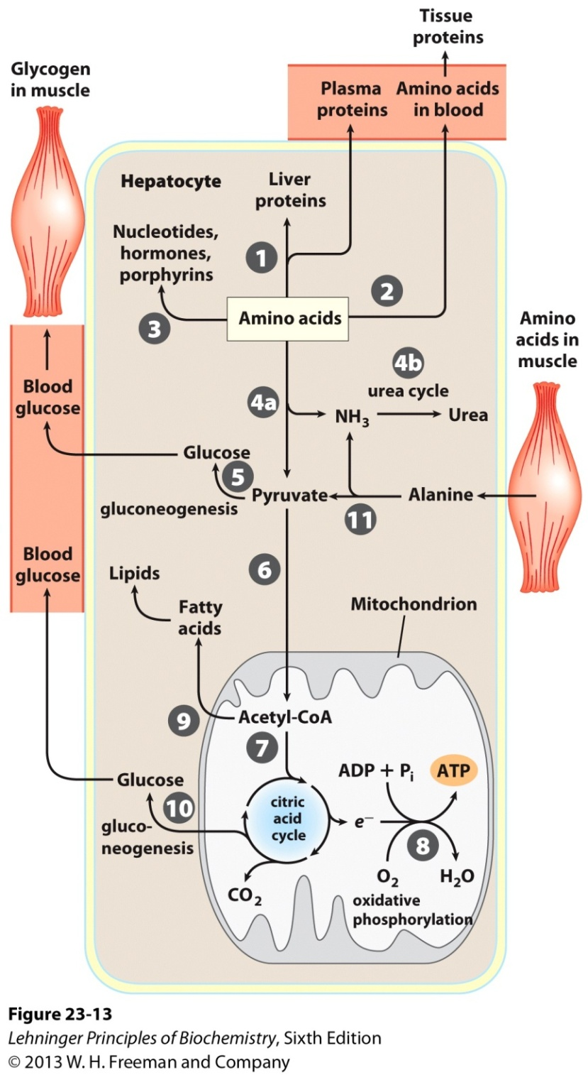
Metabolism of amino acids in the liver

Slide 8
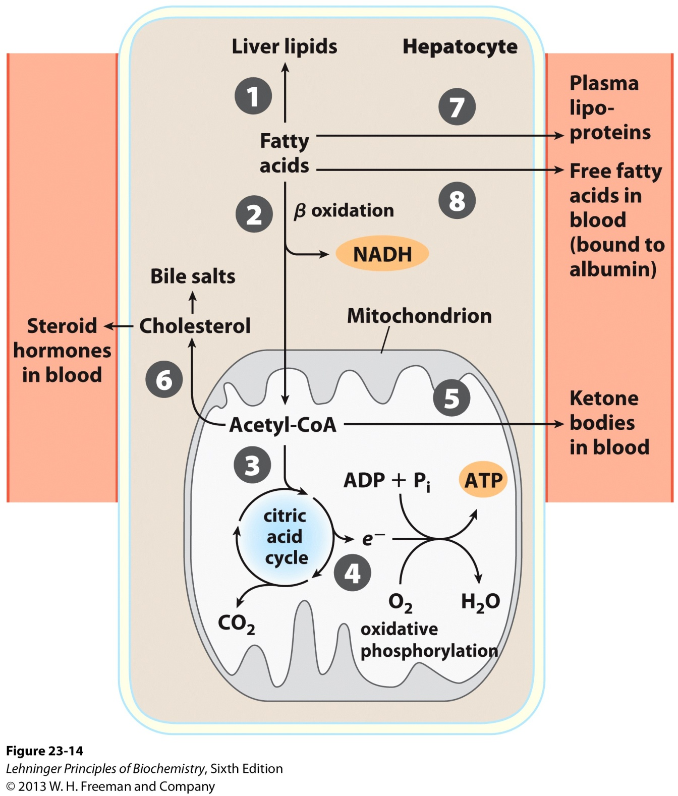
Under most circumstances,
fatty acids are the primary
oxidative fuel in the liver.
Metabolism of fatty acids in the liver

Slide 9
Adipose tissues store and supply fatty acids
Consist of adipocytes
Store triacylglycerols (TAGs)
Metabolically very active
Convert glucose to fatty acids and TAGs
Can also release free fatty acids
Lipase activity regulated by hormones (epinephrine stimulates, whereas insulin decreases the activity)

Slide 10
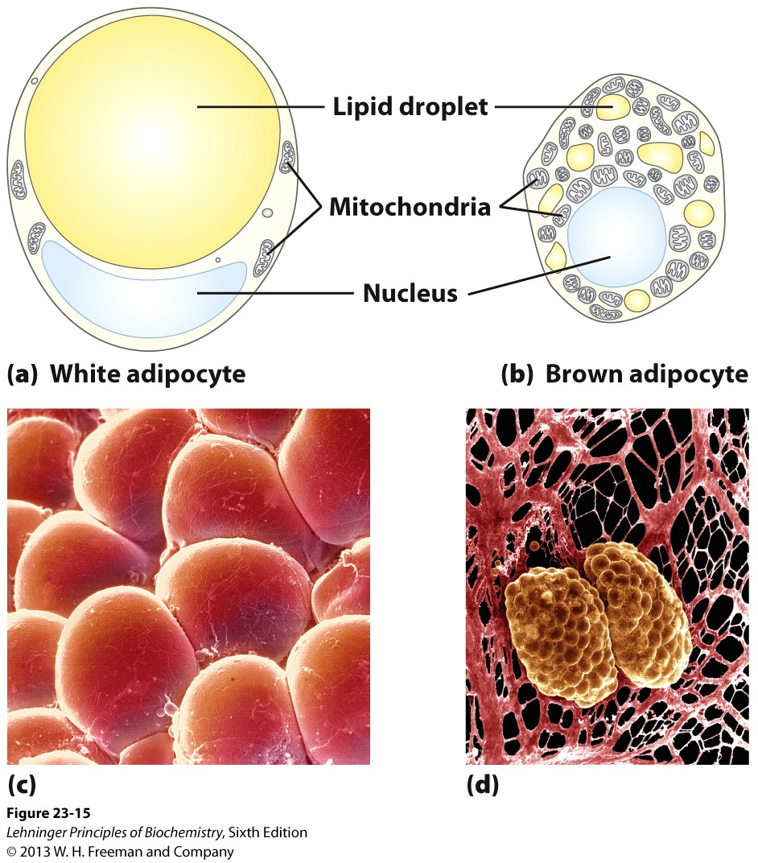
Adipocyte of white and brown adipose tissue

Slide 11
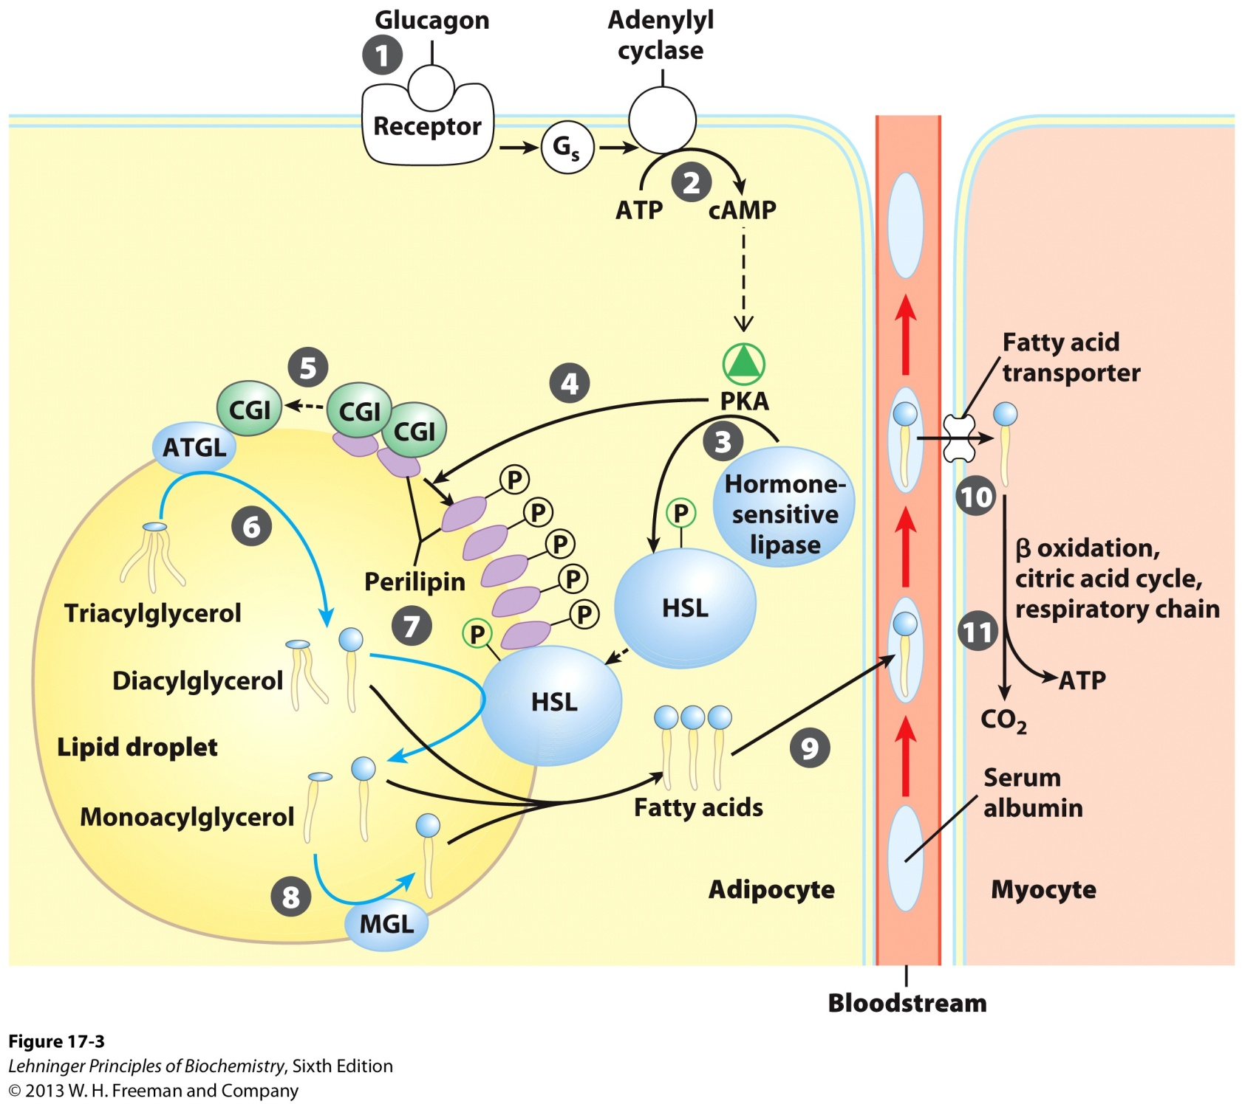
ATGL: adipose triacylglycerol lipase
HSL: hormone-sensitive lipase
MGL: monoacylglycerol lipase
Mobilization of triacylglycerols stored in adipose tissue

Slide 12
Adipose tissue has important endocrine functions
Highly specialized to play important roles in energy storage, fatty acid metabolism and glucose homeostasis
An endocrine (内分泌) organ that produces and secrets many hormones ---- adipokines, which significantly affect the metabolism of lipids and carbohydrates as well as numerous other processes in human body

Slide 13
Adipokines
Produced by adipocytes: leptin, adiponectin, resistin, visfatin, apelin, omentin, chemerin
Shared with other systems: interleukin-6 (IL-6), monocyte chemoattractant protein 1 (MCP-1), plasminogen activator inhibitor (PAI-1), tumor necrosis factor α (TNF- α)

Slide 14
Adipose tissue and adipokines

Slide 15
Leptin (瘦素)
First adipokine discovered (in 1994)
Encoded by a gene designated OB (obese)
16 kDa peptide
ob/ob mice are obese, as well as insulin-resistant
Appetite Suppressant
Act at a hypothalamic central level as a regulatory factor that induces a decrease in food intake and an increase in energy consumption

Slide 16
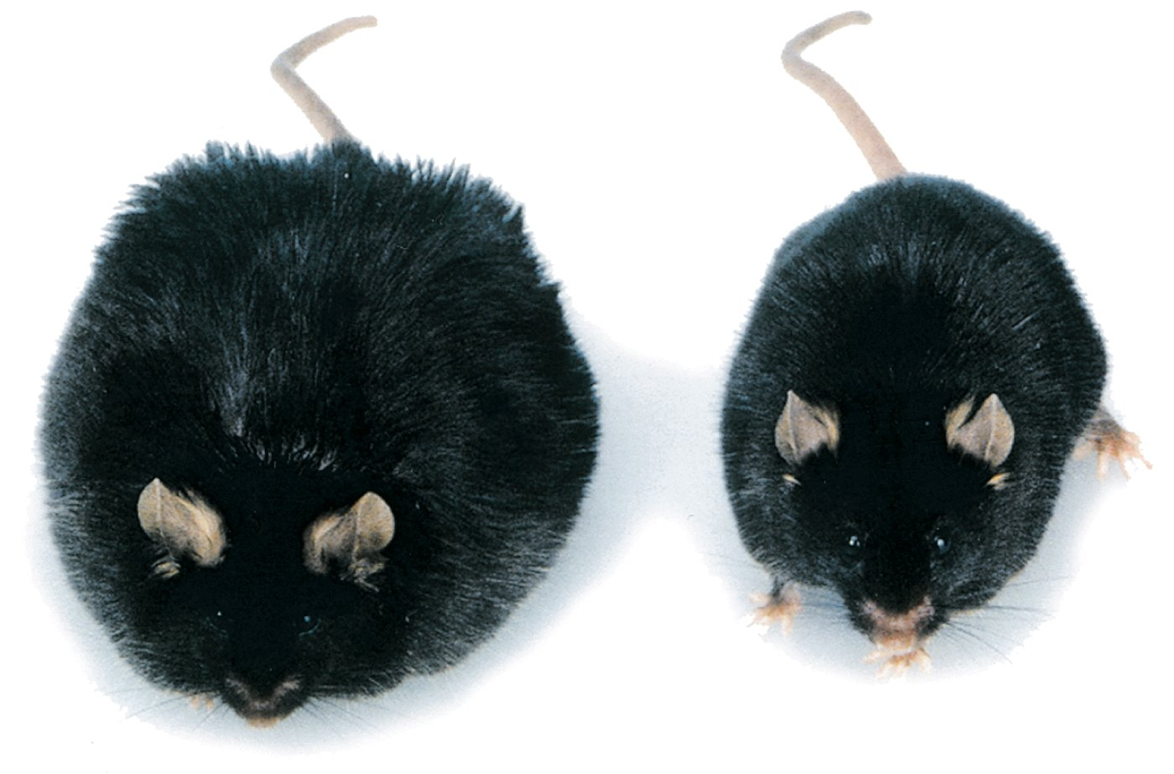
ob/ob provided with leptin
by daily injection
ob/ob
Obesity caused by defective leptin production

Slide 17
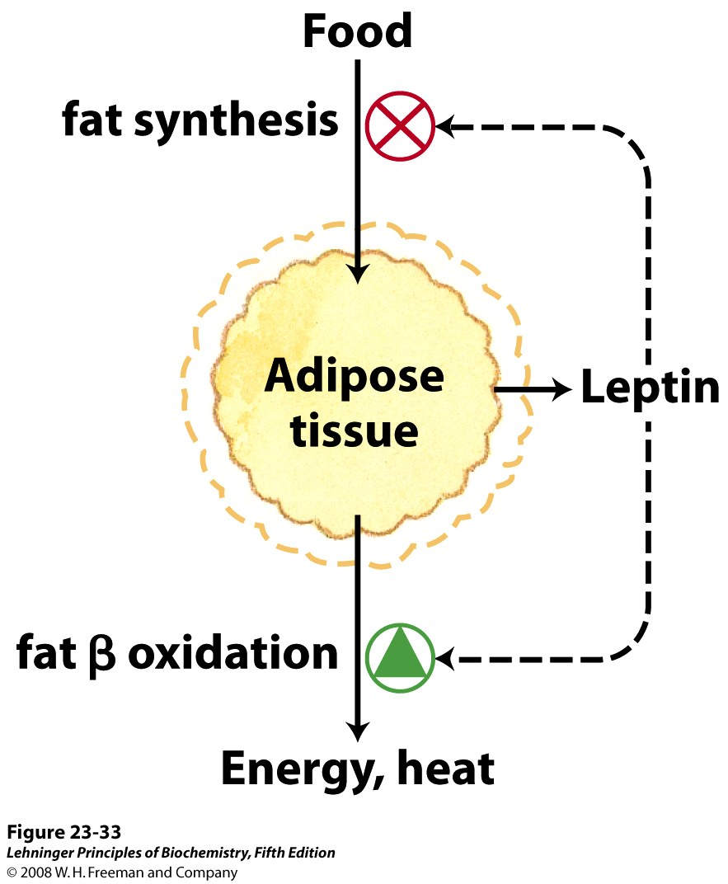
Set-point model for maintaining constant body mass

Slide 18
Adiponectin (脂联素)
Secreted exclusively by adipocytes
5-30 μg/ml in plasma, account for ~ 0.01% of total plasma protein
human adiponectin: 244 amino acids, 30kDa
Four domains:
N-terminal signal peptide (18 aa)
Short hypervariable region
Collagenous domain (22 repeated Gly-X-Y motifs)
C-terminal globular domain homologous to C1q

Slide 19
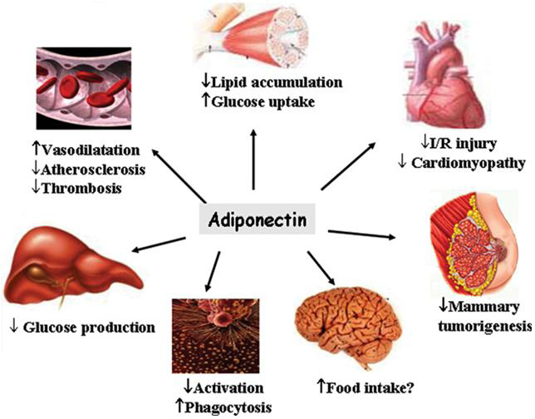
Function of adiponectin

Slide 20
Adiponectin and insulin sensitivity
Anti-diabetic, anti-inflammatory, anti-atherogenic, anti-atherosclerotic, and insulin-sensitizing effects
Decrease in patients with type 2 diabetes, obese, metabolic syndrome, hypertension as well as coronary artery disease
Present in inverse proportion to the degree of insulin resistance
Increases with weight loss, caloric restriction or treatment with thiazolidinediones (TZD), which are PPARγ agonists.

Slide 21
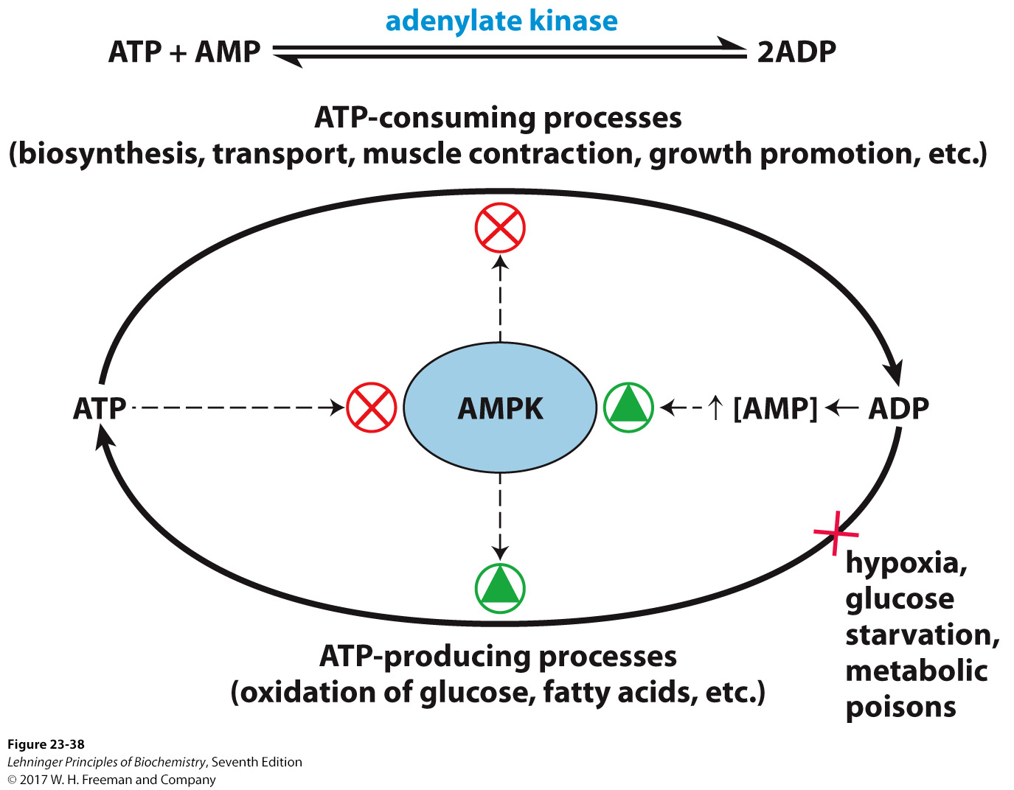
The role of AMPK in maintaining energy homeostasis
Notes:
FIGURE 2338 The role of AMP-activated protein kinase (AMPK) in maintaining energy homeostasis. ADP produced by synthetic reactions is converted to ATP and AMP by adenylate kinase. AMP activates AMPK, which reciprocally regulates ATP-consuming and ATP-generating pathways by phosphorylating key enzymes (see Fig. 23-39). Conditions or agents that inhibit ATP production by catabolic reactions (such as hypoxia, lack of glucose, metabolic poisons) raise [AMP], activate AMPK, and stimulate catabolism. Cellular or organismal activities that consume ATP (muscle contraction, growth) increase [AMP] and stimulate catabolic reactions to replenish ATP. When [ATP] is high, ATP prevents AMP binding to AMPK, thus lowering AMPK activity and slowing catabolism.

Slide 22
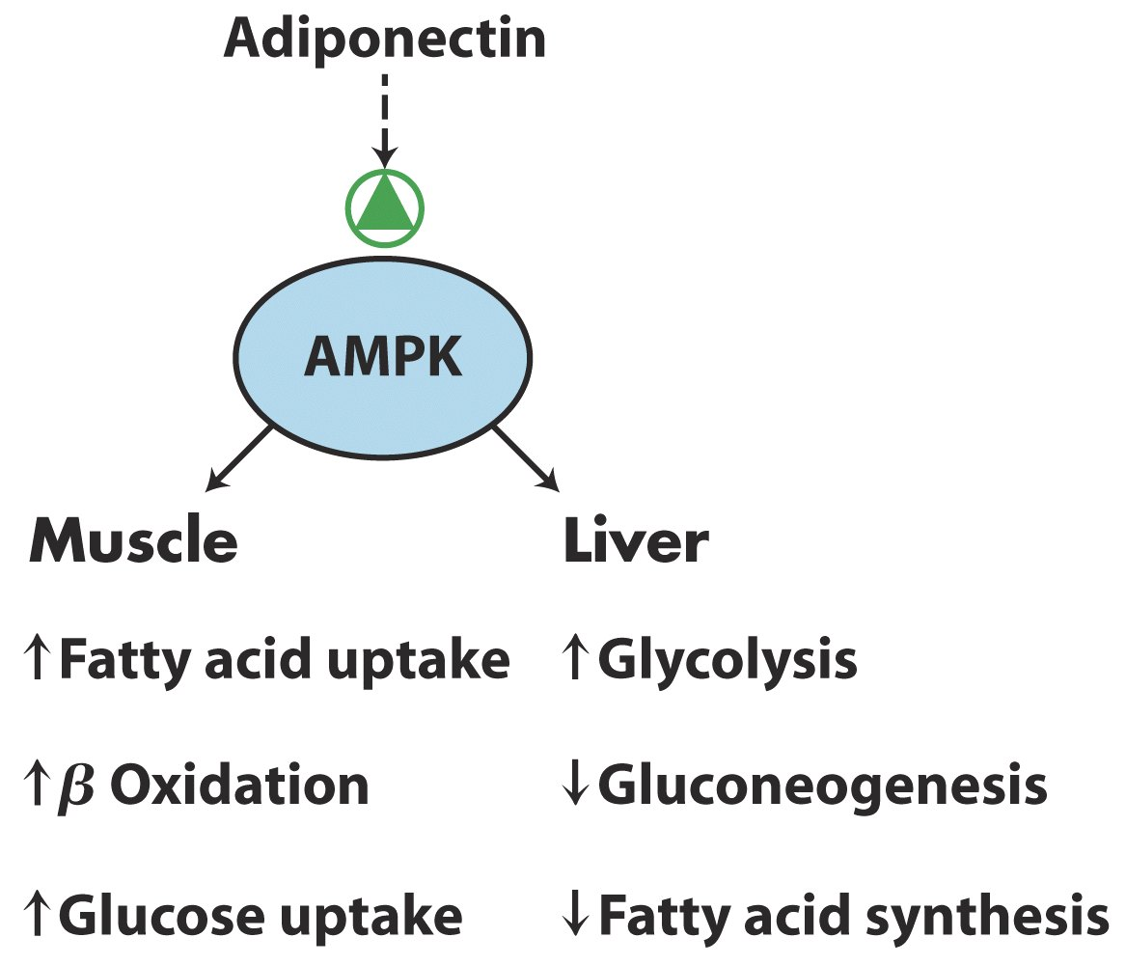
(AdipoR1)
(AdipoR2)
Effects of adiponectin on muscle and liver

Slide 23
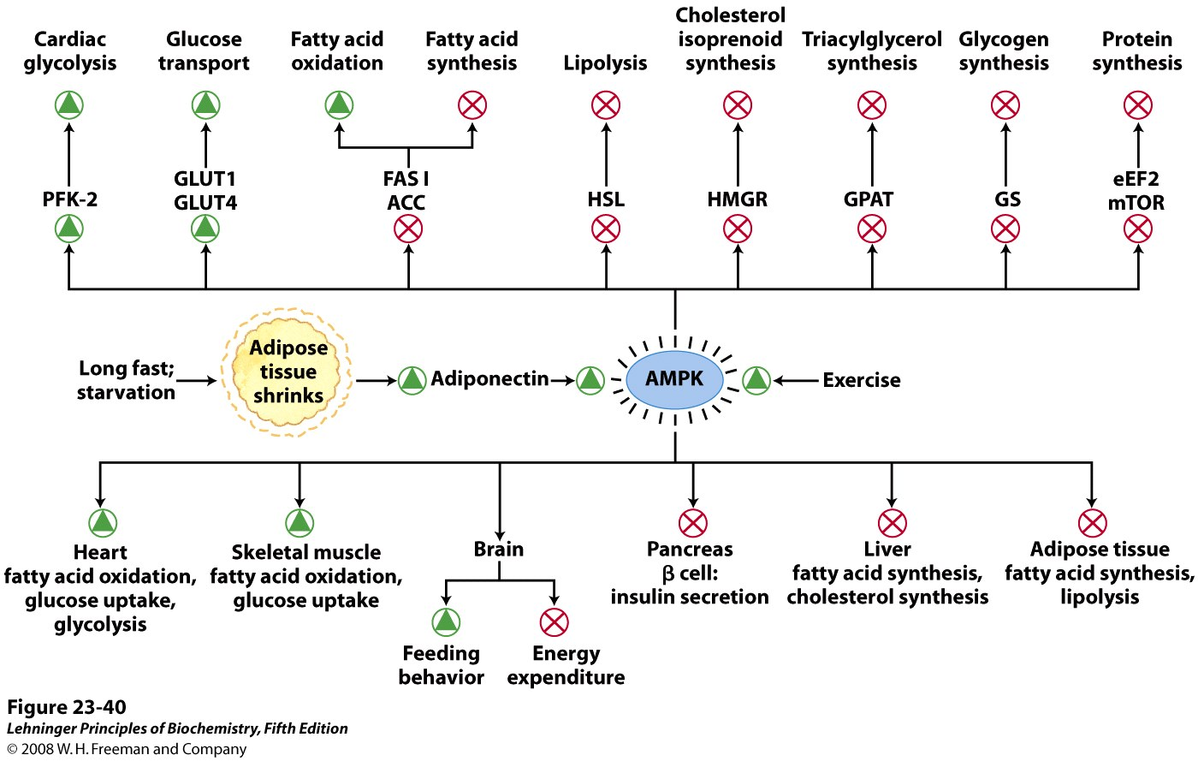
Formation of adiponectin and its actions through AMPK
Notes:
FIGURE 23-40 Formation of adiponectin and its actions through AMPK. Extended fasting or starvation results in decreased reserves of triacylglycerols in adipose tissue, which triggers adiponectin production and release from adipocytes. The rise in plasma adiponectin acts through its plasma membrane receptors in various cell types and organs to inhibit energy-consuming processes and stimulate energy-producing processes. Adiponectin acts through its receptors in the brain to stimulate feeding behavior and inhibit energy-consuming physical activity, and to inhibit thermogenesis in brown fat. This hormone exerts its metabolic effects by activating AMPK, which regulates (by phosphorylation) specific enzymes in key metabolic processes (see Figure 15-6). PFK-2, phosphofructokinase-2; GLUT1 and GLUT4, glucose transporters; FAS I, fatty acid synthase I; ACC, acetyl-CoA carboxylase; HSL, hormone-sensitive lipase; HMGR, HMG-CoA reductase; GPAT, acyl transferase; GS, glycogen synthase; eEF2, eukaryotic elongation factor 2 (required for protein synthesis; see Chapter 27); mTOR, mammalian target of rapamycin (a protein kinase that regulates protein synthesis on the basis of nutrient availability). Thiazolidinedione drugs activate the transcription factor PPARγ (see Figure 23-41, 23-42), which then turns on adiponectin synthesis, indirectly activating AMPK. Exercise, through conversion of ATP to ADP and AMP, also stimulates AMPK.

Slide 24
Brown adipose tissue (BAT) is thermogenic
Small size
Polygonal shape
Store triacylglycerols in small lipid droplets
Rich in mitochondria and capillaries
Strong expression of UNC1 encoding thermogenin, the uncoupling protein
Principle function of BAT---thermogenesis

Slide 25
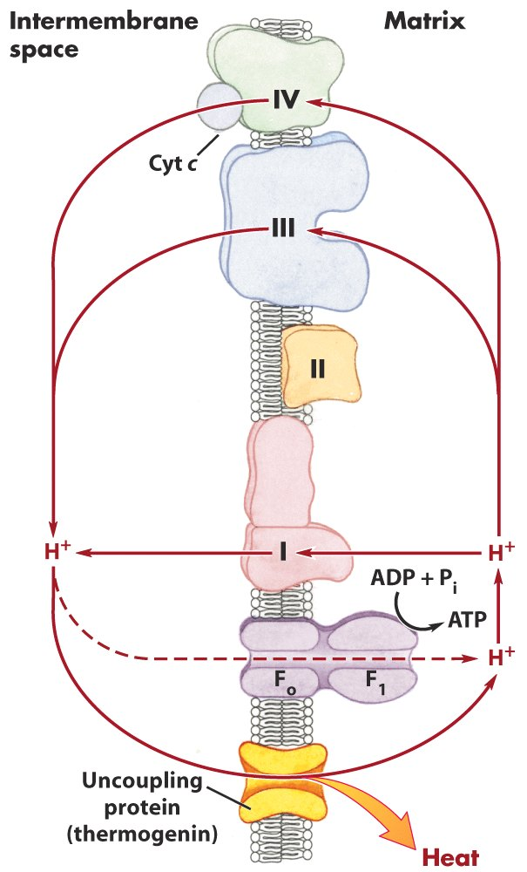
Thermogenin of brown
fat mitochondria causes
the energy conserved by
proton pumping to be
dissipated as heat.

Slide 26
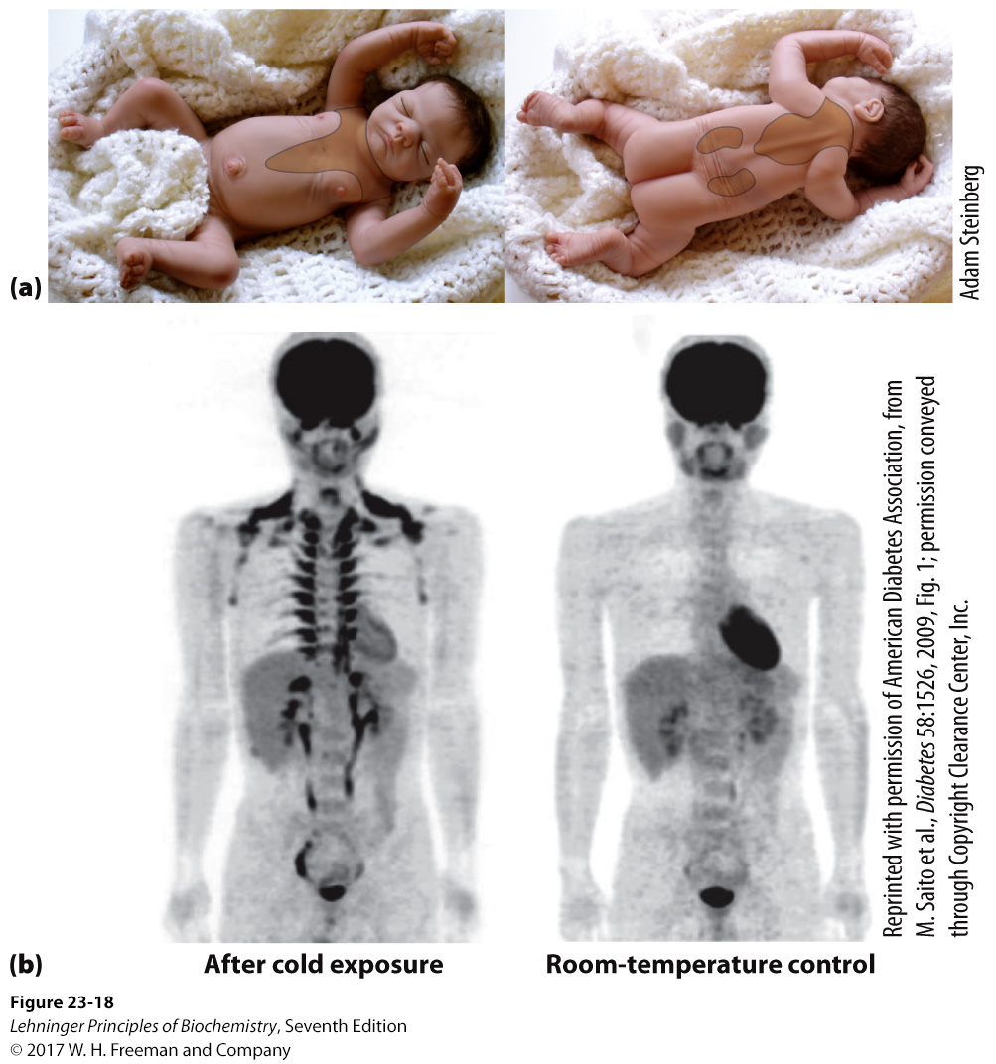
BAT protects the
major blood vessels
and the internal organs
of a newborn infant.
A healthy 25-year-old man stayed for 1 hour in a 19ºC room, with his legs on ice to thoroughly chill him
Adults have brown
fat deposits, which
are metabolically
active only when the core body temperature is relatively low.
The same man stayed for 2 hours at 27ºC
Brown adipose tissue in infants and adults
Notes:
FIGURE 23–18 Brown adipose tissue in infants and adults. (a) At birth, human infants have brown fat distributed as shown here, to protect the spine, major blood vessels, and the internal organs. (b) Positron emission tomography (PET) scanning can show metabolic activity in a living person, in real time. PET scans allow visualization of isotopically labeled glucose in precisely localized regions of the body. A positron-emitting glucose analog, 2-[¹⁸F]-fluoro-2-deoxy D-glucose (FDG), is injected into the bloodstream; a short time later, a PET scan shows how much of the glucose has been taken up by each part of the body—a measure of metabolic activity. On the left is a PET scan of a healthy 25-year-old man who fasted for 12 hours, then stayed for 1 hour in a cold (19 °C) room, with his legs on ice to thoroughly chill him. At the end of the hour, he was injected with [¹⁸F]-FDG, then remained under cold conditions for another hour. Whole-body PET scans were then done at 24 °C. For the control scan, the same man underwent the same PET scan protocol two weeks later, but this time following 2 hours at 27 °C instead of chilling (right). Intense labeling of the brain and heart shows high rates of glucose uptake; labeling of the kidneys and bladder indicates clearance of FDG. In the scan after chilling (left), [¹⁸F]-FDG labels BAT in the region above the collarbone and along the vertebrae.

Slide 27
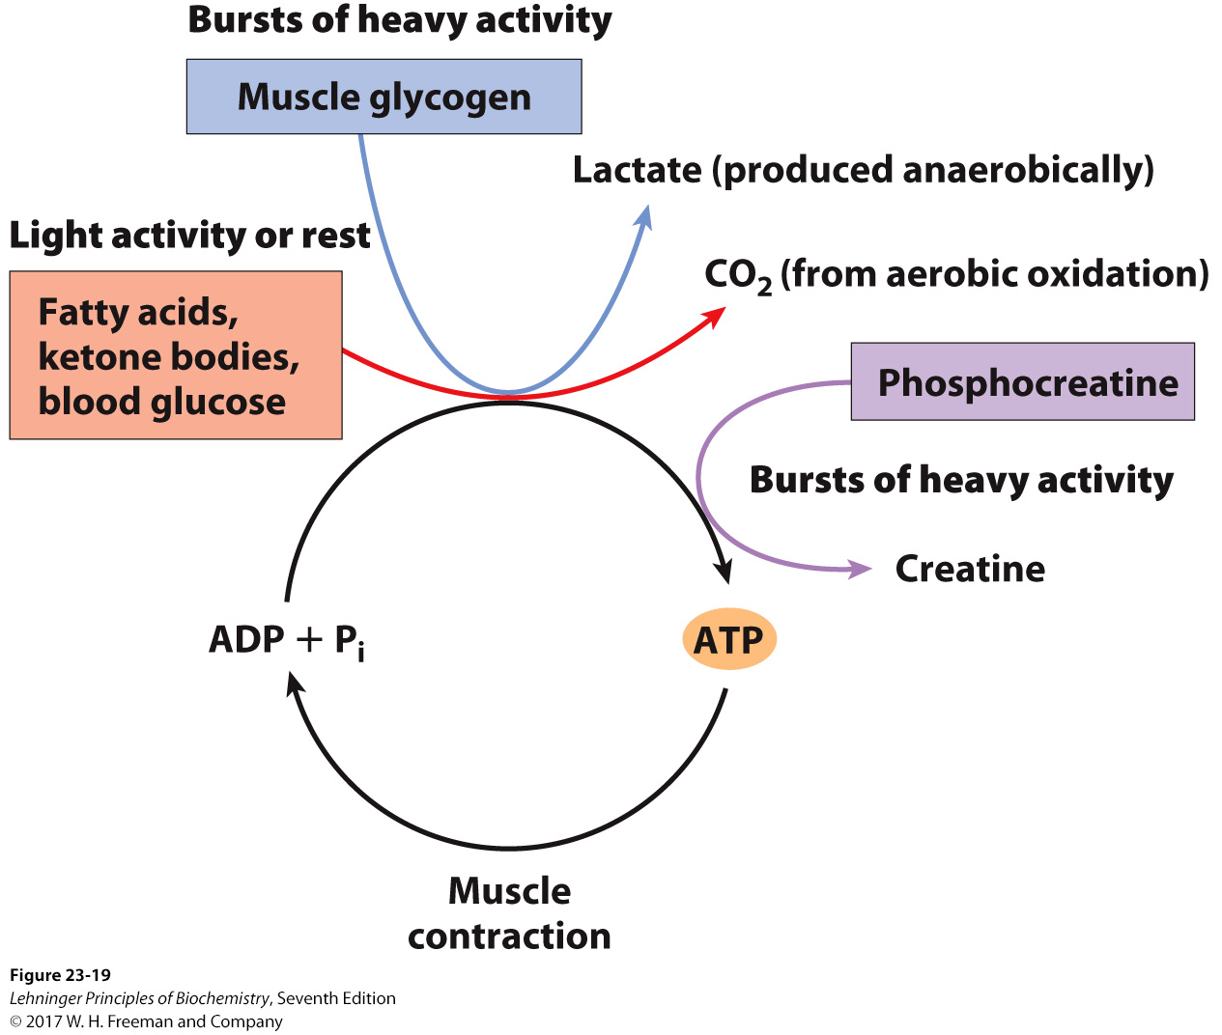
Epinephrine stimulates
glycogen breakdown.
Energy sources for muscle contraction

Slide 28
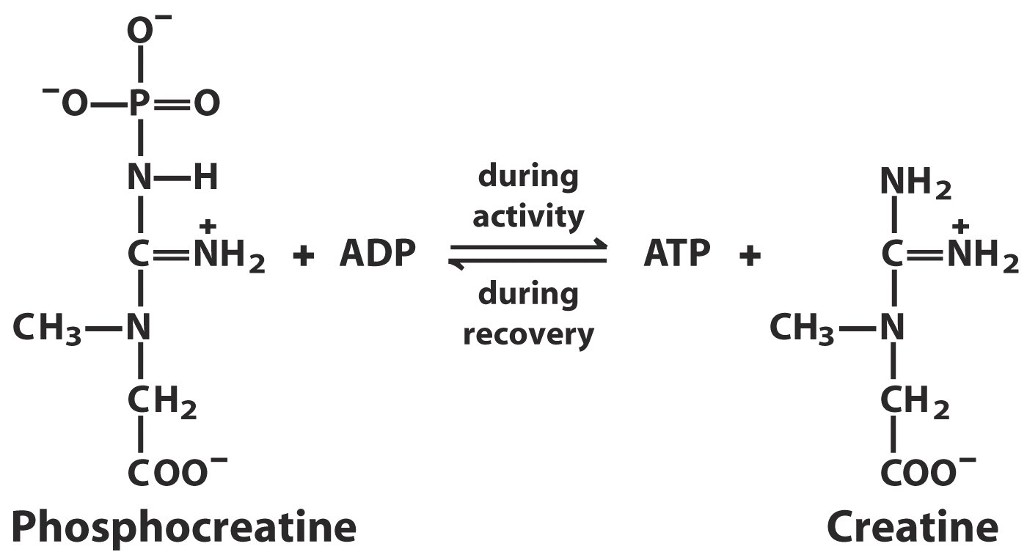
磷酸肌酸
ATP can be generated rapidly from phosphocreatine

Slide 29
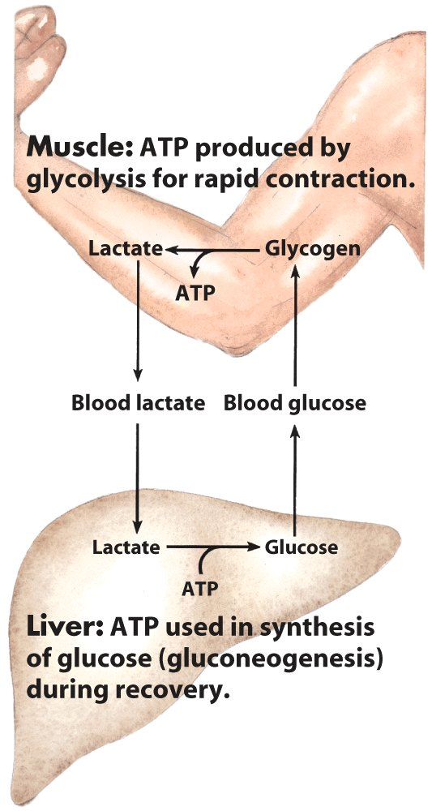
Metabolic cooperation
between skeletal muscle
and the liver
The Cori cycle

Slide 30
Heart
Continuously active in a regular rhythm of contraction and relaxation
Uses glucose, fatty acid and ketone bodies as fuels
Aerobic metabolism, obtain energy form oxidative phosphorylation
Heart attack happened when blood vessels are blocked by lipid droplets (atherosclerosis, 动脉粥样硬化) or blood clots (coronary thrombosis, 冠状动脉栓塞症)

Slide 31
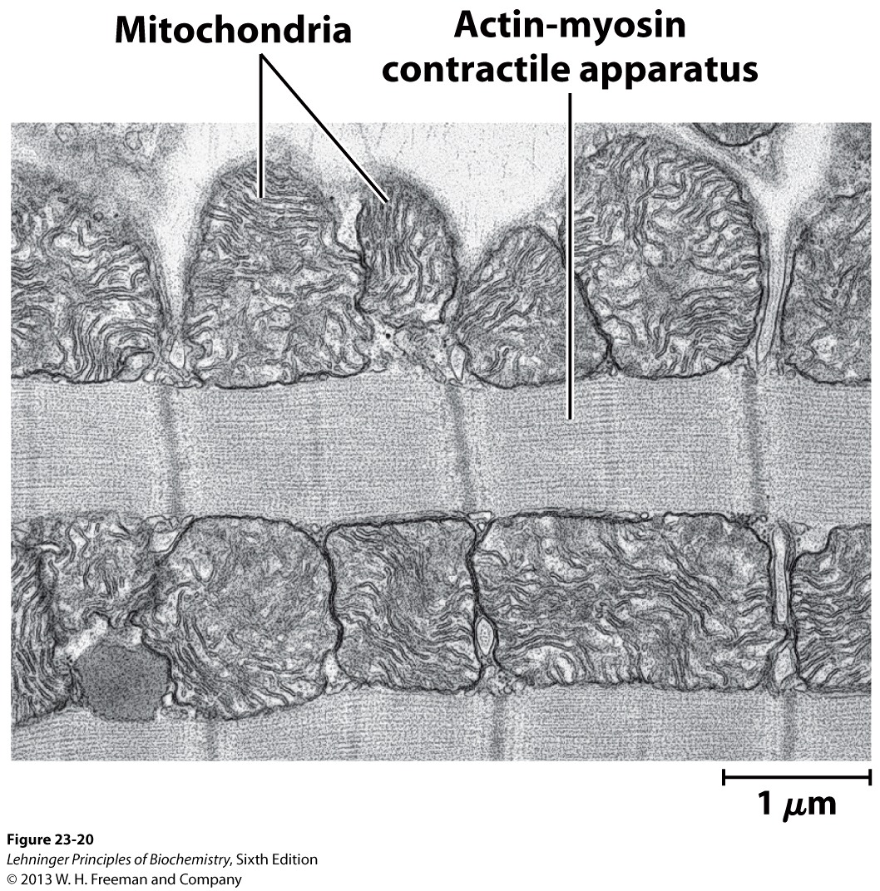
The heart uses glucose, fatty acid and ketone bodies as fuels --- completely aerobic metabolism

Slide 32
The brain uses energy for transmission of electrical impulses
Uses only blood glucose as fuel normally
Has a very active respiratory metabolism, consuming 20% of the total O₂ consumed by the body at rest
The ketone body used is β-hydroxybutyrate
Energy is used to create and maintain an electrical potential across the plasma membrane of the neurons.

Slide 33
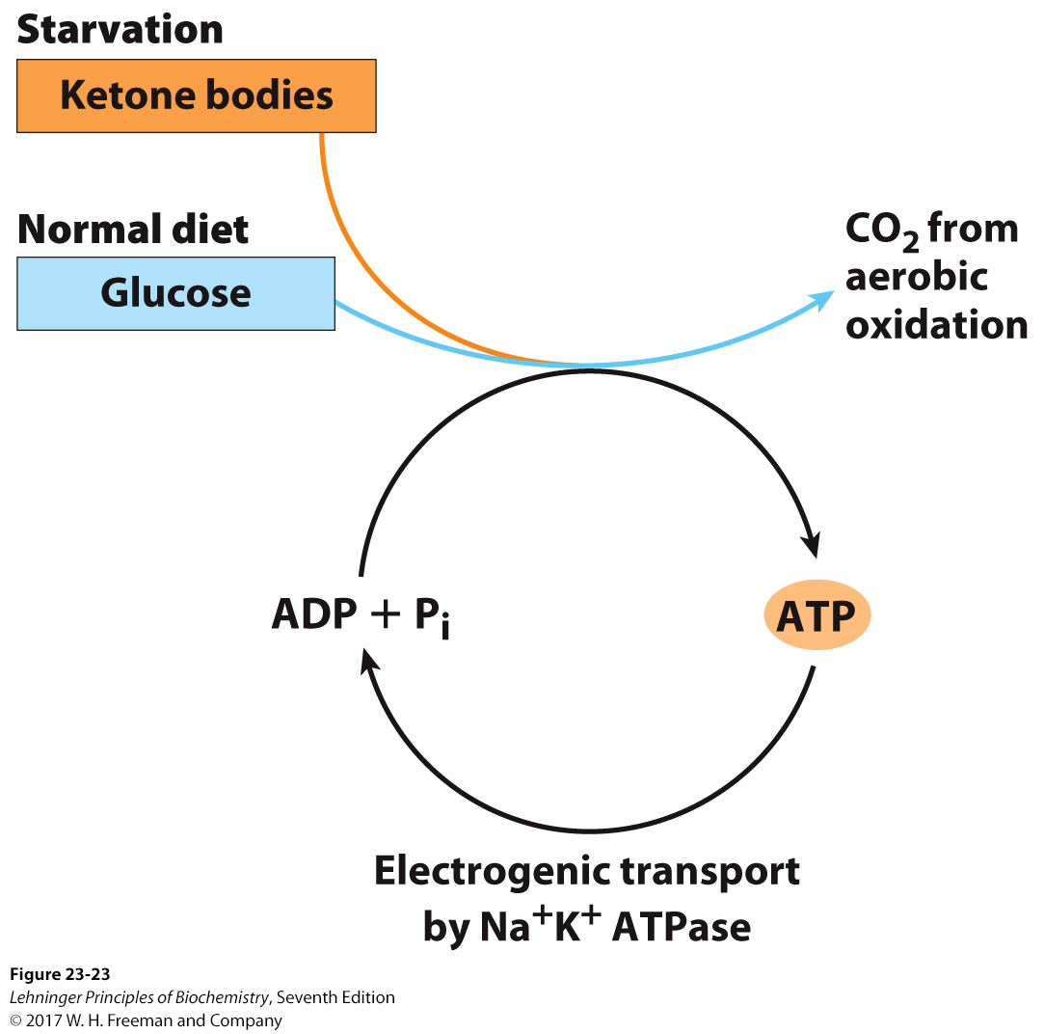
β-hydroxybutyrate
Severe or sometimes
irreversible changes
in brain function may result
when blood glucose
level falls below a critical
level even for a short time!!!
Energy sources in the brain vary with nutritional state

Slide 34
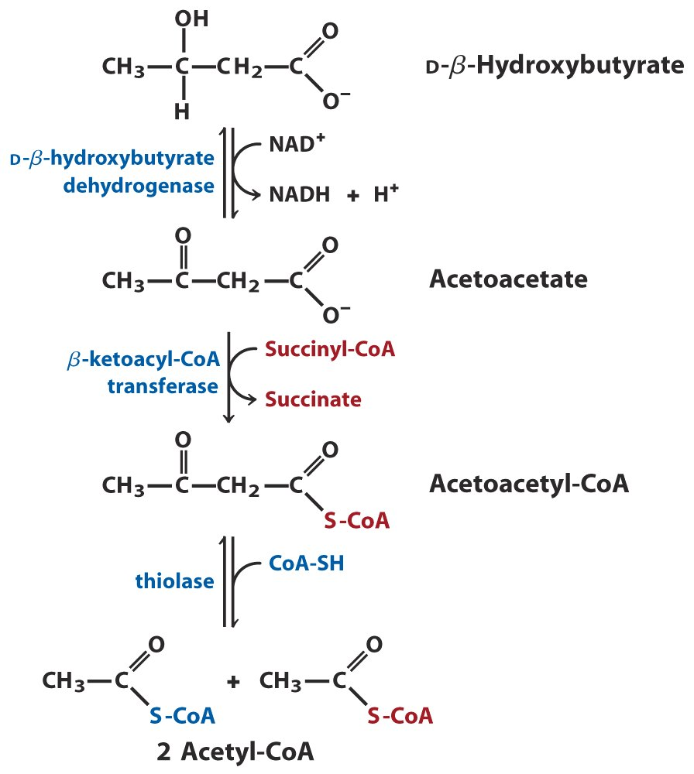
Not present
in liver
β-hydroxybutyrate can be used as a fuel by extrahepatic tissues

Slide 35
Blood mediates the metabolic interactions among all tissues
Transports nutrients
Transports waste products to the kidney for excretion
Carries hormones
Can be separated into blood plasma and cells by centrifugation

Slide 36
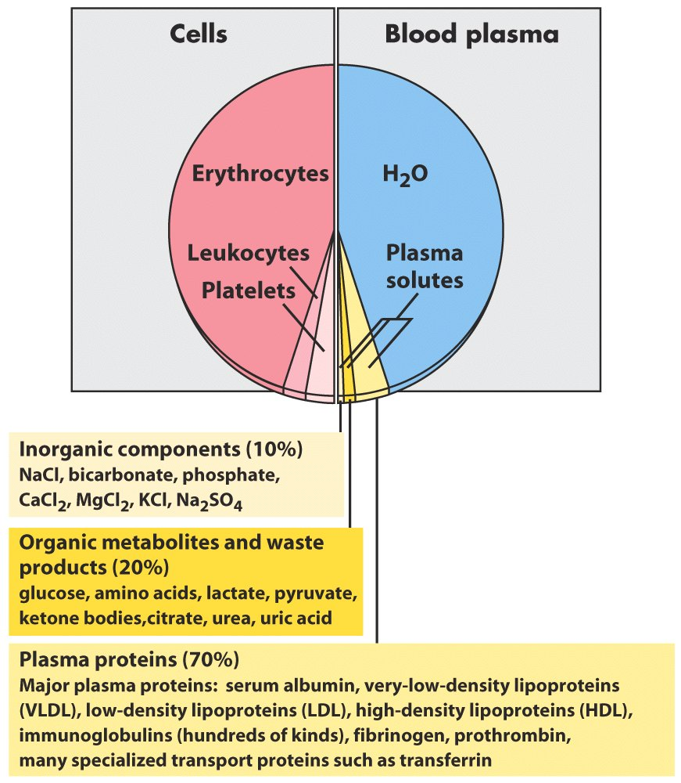
血浆
(90%)
Measurements of the concentration
of components in blood plasma
are important in the diagnosis
and treatment of many diseases
The composition of blood

Slide 37
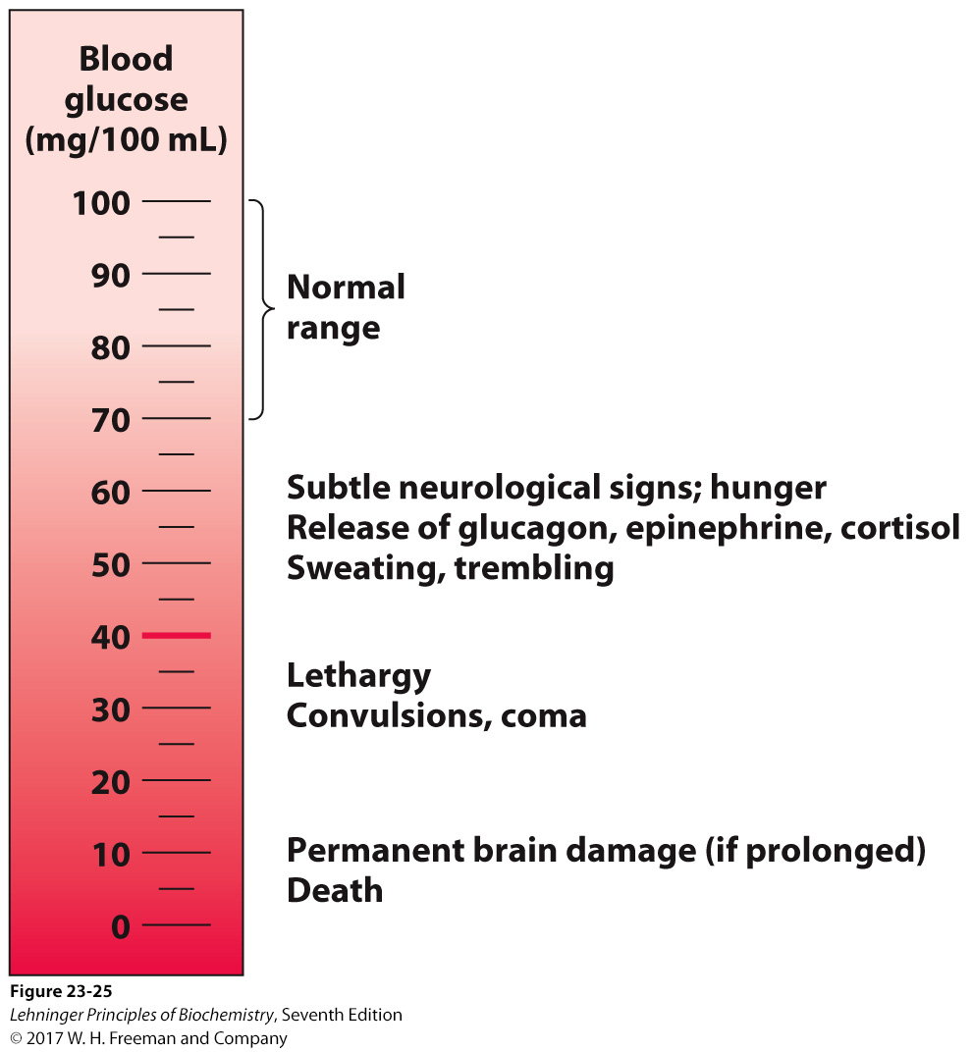
Maintaining the normal
concentration of glucose
in the blood is a very high
priority of the organism
Hypoglycemia 低血糖
Physiological effects of low blood glucose in humans

Slide 38
Hormonal regulation of fuel metabolism
Hormones coordinate and integrate the metabolic activities of all the tissues to produce homeostasis in the animal.
Epinephrine signals impending activity.
Glucagon signals low blood glucose level.
Insulin signals high blood glucose level.
Cortisol signals stress, including low blood glucose.

Slide 39
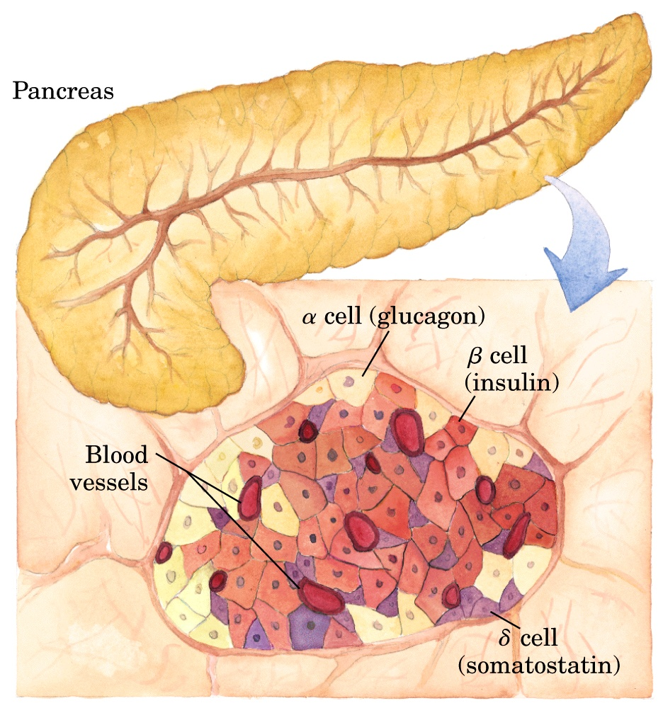
Islets of Langerhans
Insulin released by the
pancreas is largely
regulated by the level
of glucose in the blood
supplied to the pancreas
The endocrine system of the pancreas

Slide 40
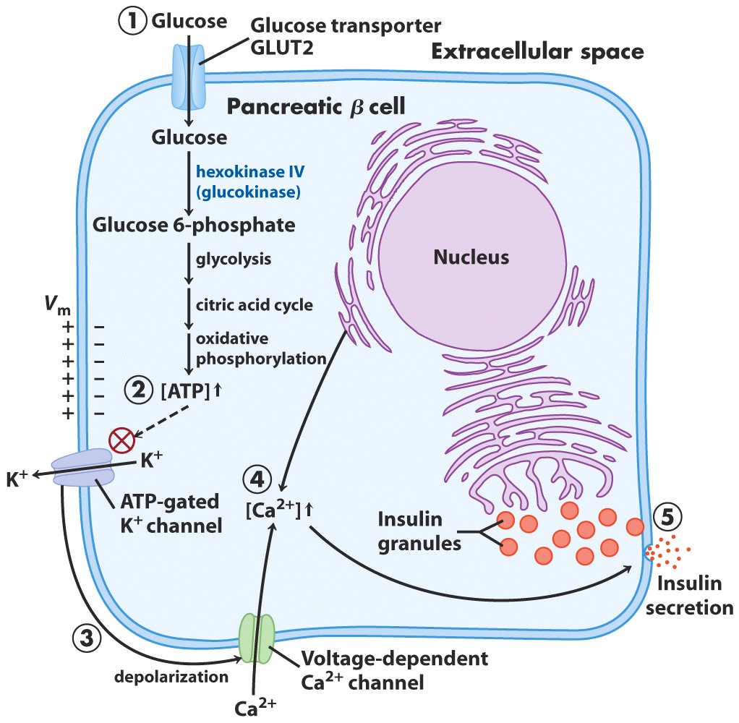
Glucose regulation of insulin secretion by pancreatic β cells

Slide 41
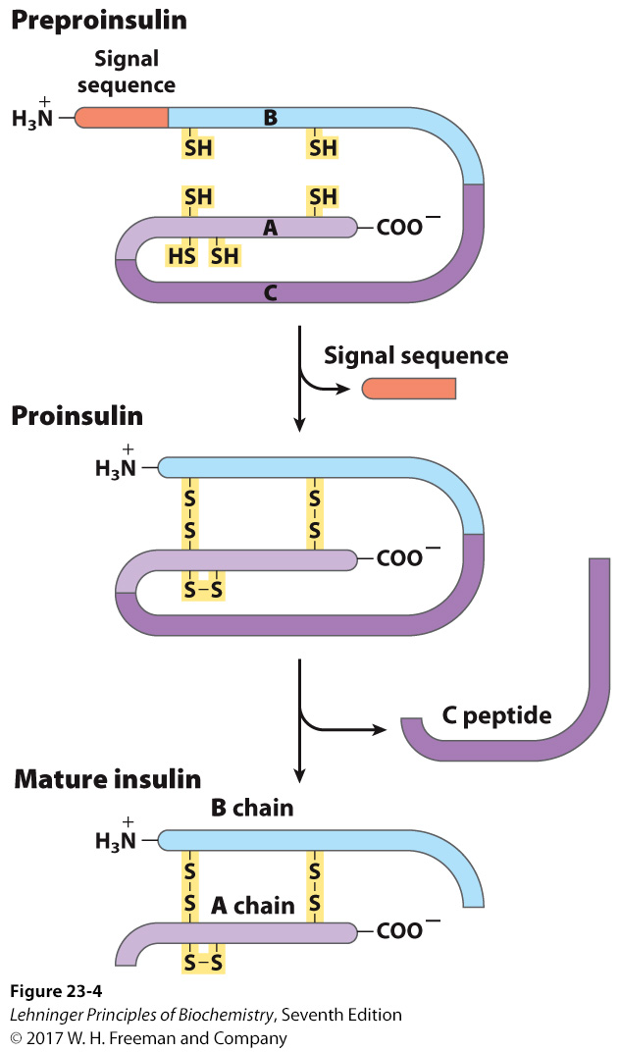
Insulin is formed from its large precursor preproinsulin by proteolytic processing
Notes:
FIGURE 23–4 Insulin. Mature insulin is formed from its larger precursor preproinsulin by proteolytic processing. Removal of a 23 amino acid segment (the signal sequence) at the amino terminus of preproinsulin and formation of three disulfide bonds produces proinsulin. Further proteolytic cuts remove the C peptide from proinsulin to produce mature insulin, composed of A and B chains. The amino acid sequence of bovine insulin is shown in Figure 3–24.

Slide 42
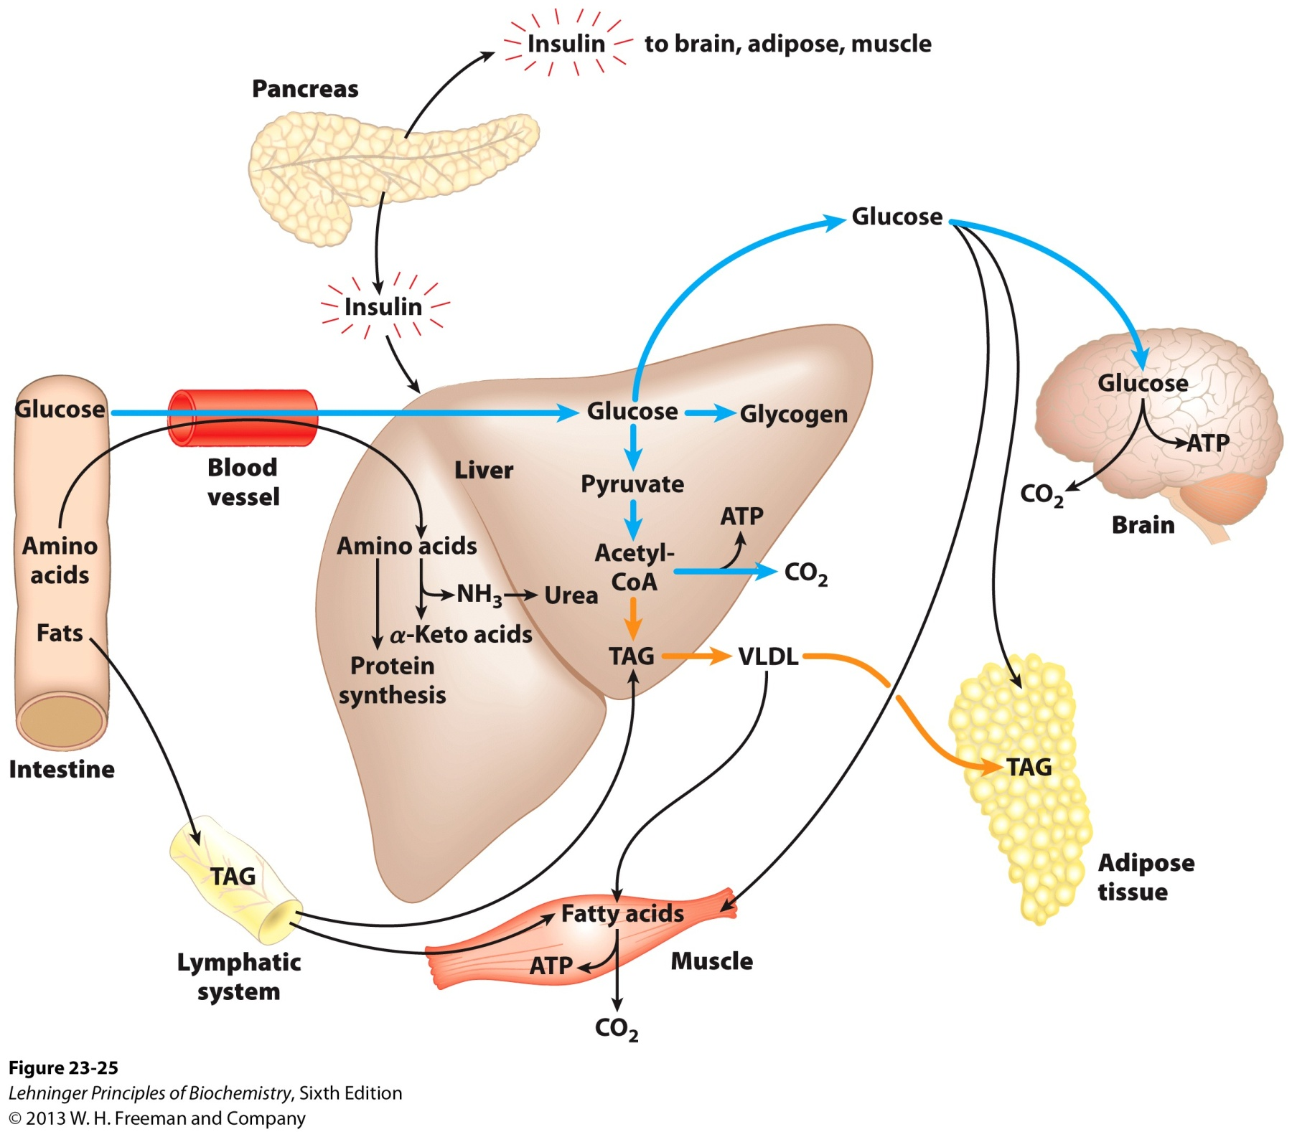
The well-fed state: the lipogenic liver

Slide 43
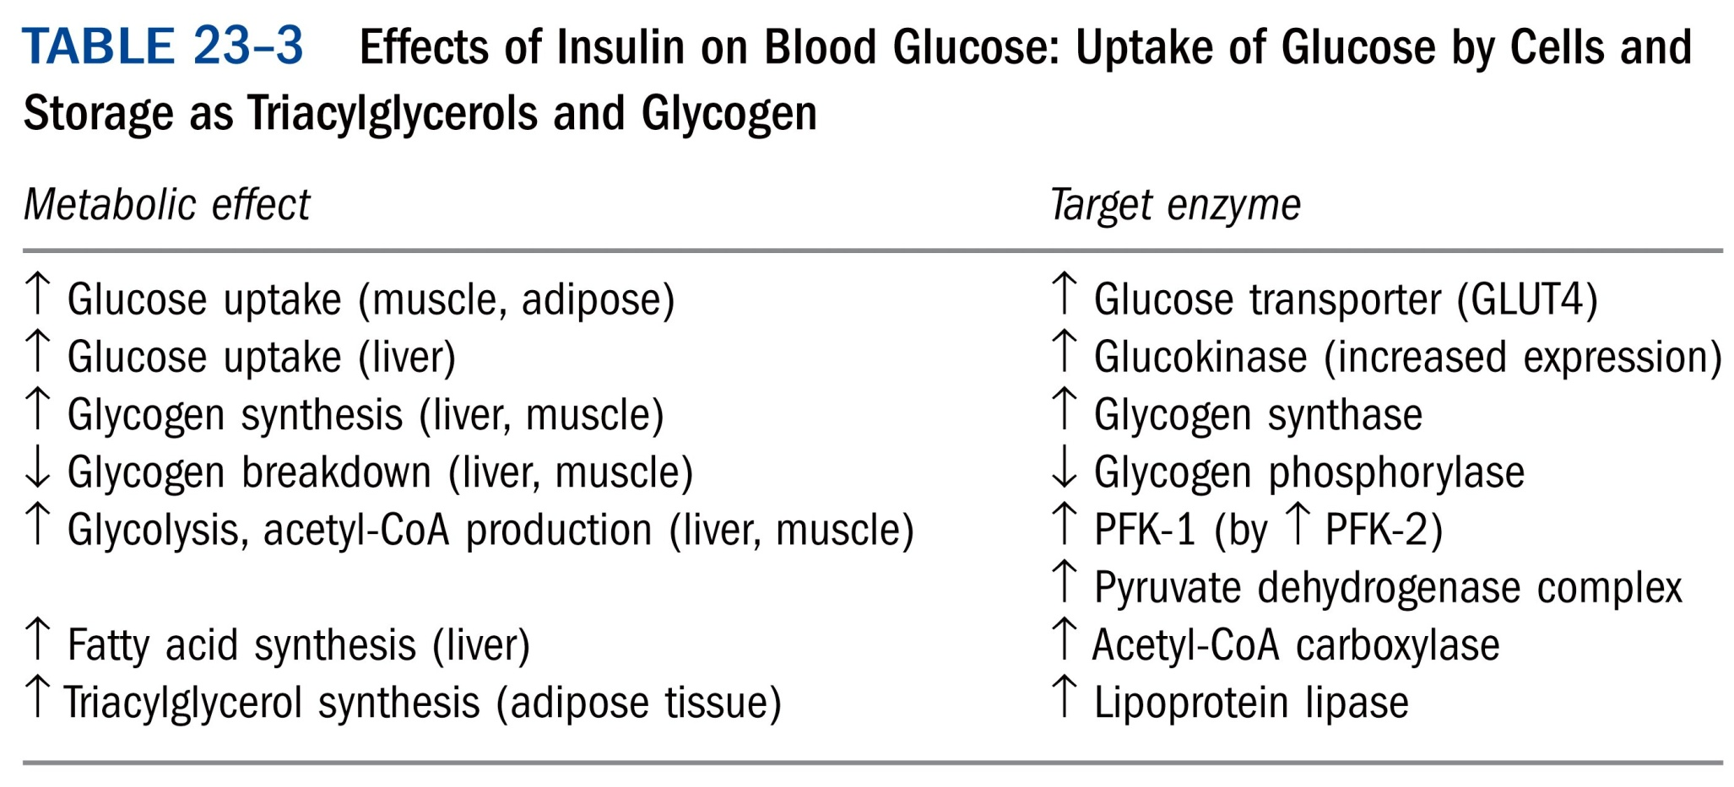
*****

Slide 44
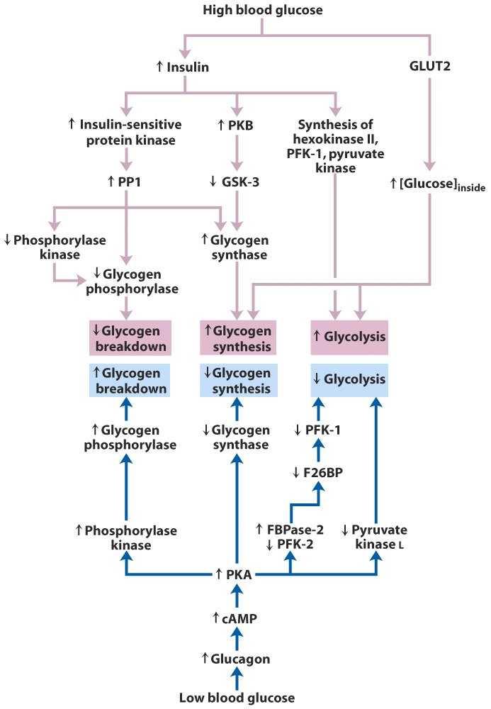
Glycogen
synthesis
Glycogen
breakdown
Regulation of carbohydrate metabolism in the hepatocyte

Slide 45
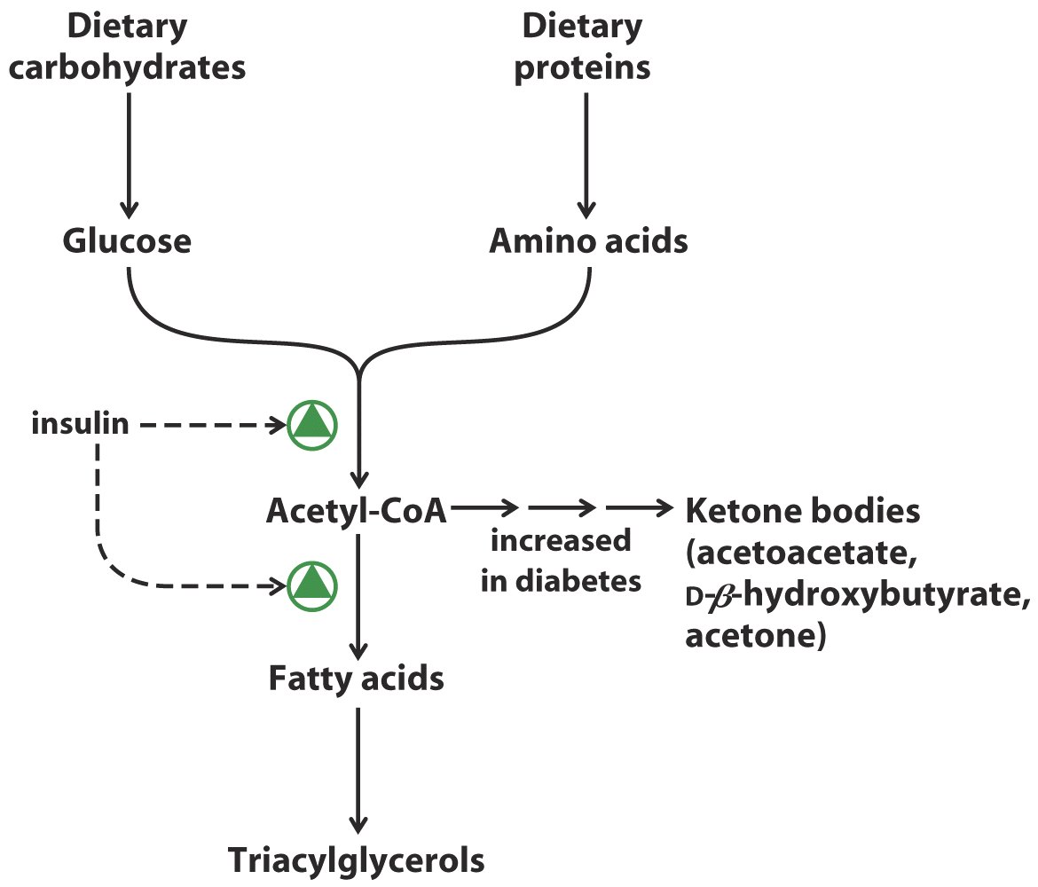
Regulation of triacylglycerol synthesis by insulin

Slide 46
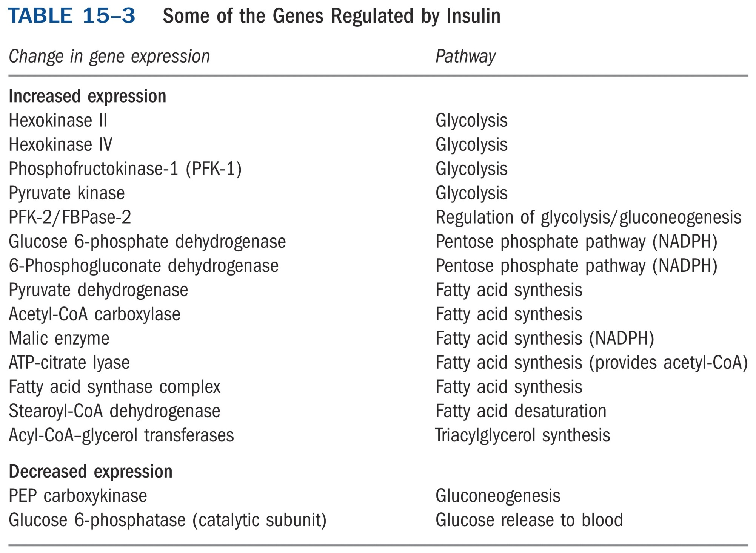
*****

Slide 47
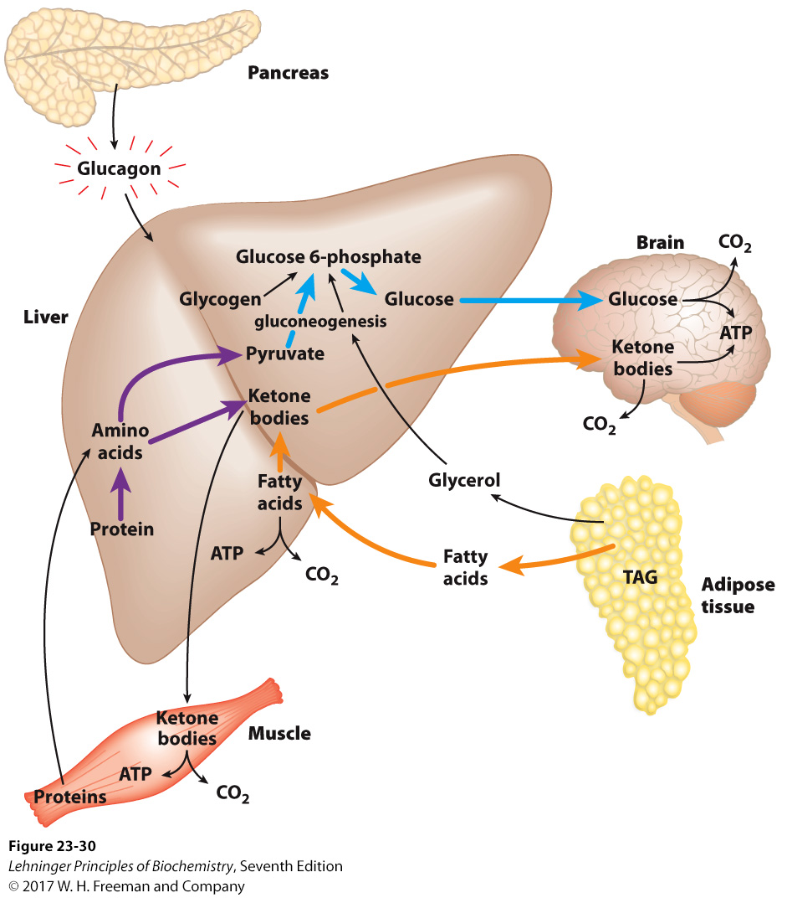
The fasting state: the glucogenic liver
Notes:
FIGURE 2330 The fasting state: the glucogenic liver. After some hours without a meal, the liver becomes the principal source of glucose for the brain. Liver glycogen is broken down to glucose 1-phosphate, and this is converted to glucose 6-phosphate, then to free glucose, which is released into the bloodstream. Amino acids from the degradation of proteins in liver and muscle, and glycerol from the breakdown of TAGs in adipose tissue, are used for gluconeogenesis. The liver uses fatty acids as its principal fuel, and excess acetyl-CoA is converted to ketone bodies for export to other tissues; the brain is especially dependent on this fuel when glucose is in short supply (see Fig. 23-23). Blue arrows follow the path of glucose; orange arrows, the path of lipids; and purple arrows, the path of amino acids.

Slide 48
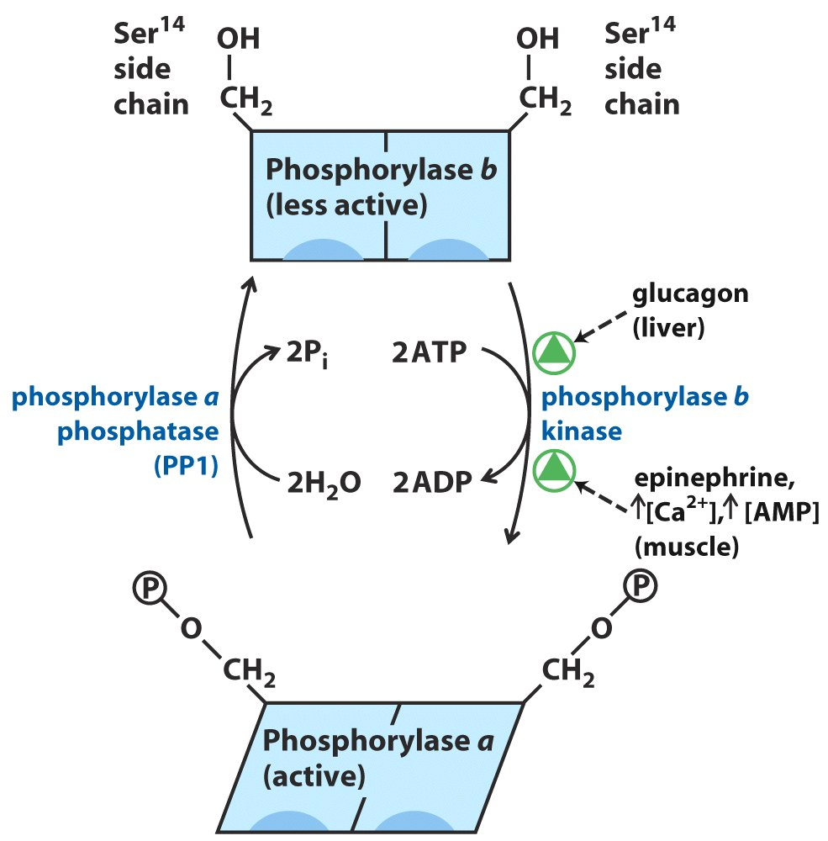
Covalent modification of glycogen phosphorylase

Slide 49
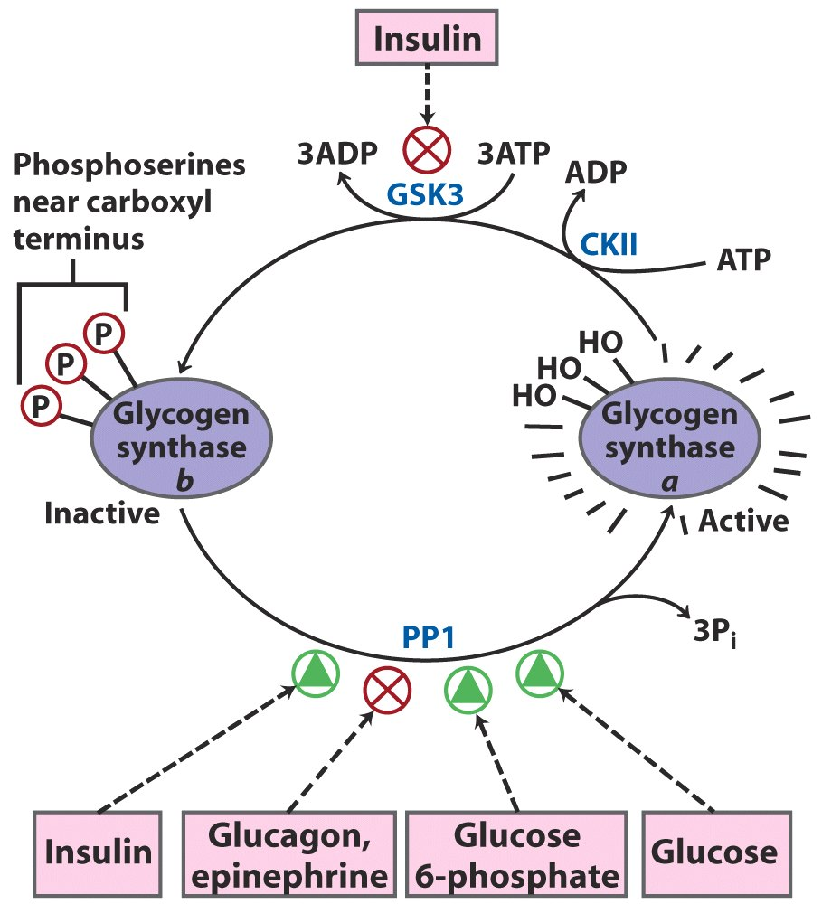
Effects of GSK3 on glycogen synthase activity

Slide 50
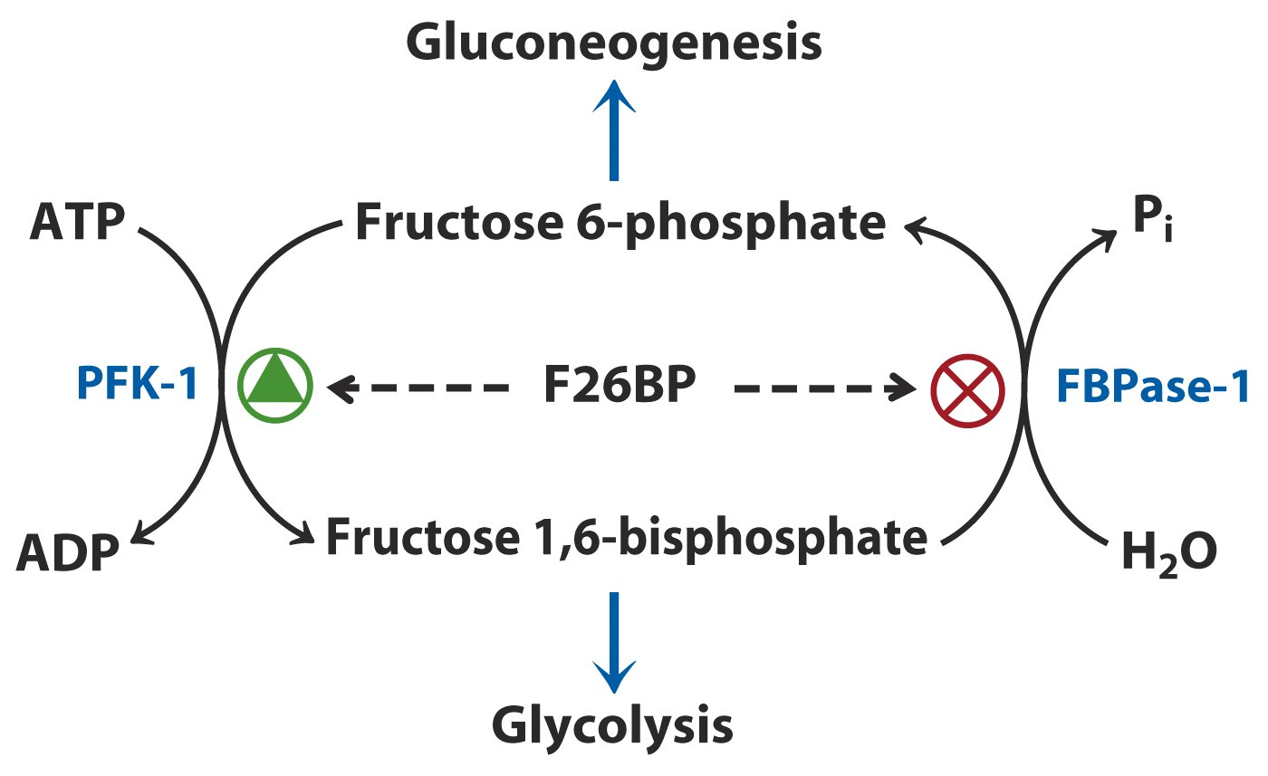
Regulation of PFK-1 and FBPase-1
by fructose-2,6-bisphosphate (F26BP)

Slide 51
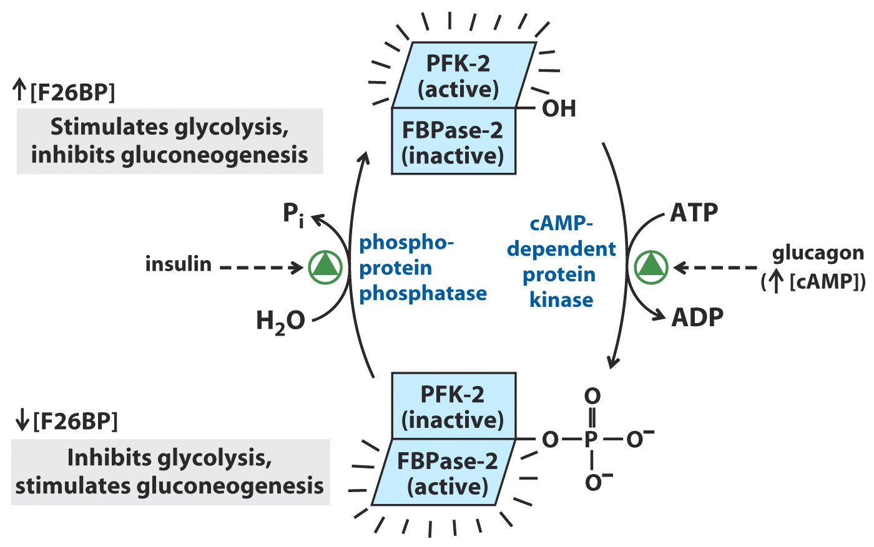
FPK-2 and FBPase-2 are regulated,
in a reciprocal way, by glucagon and insulin.

Slide 52
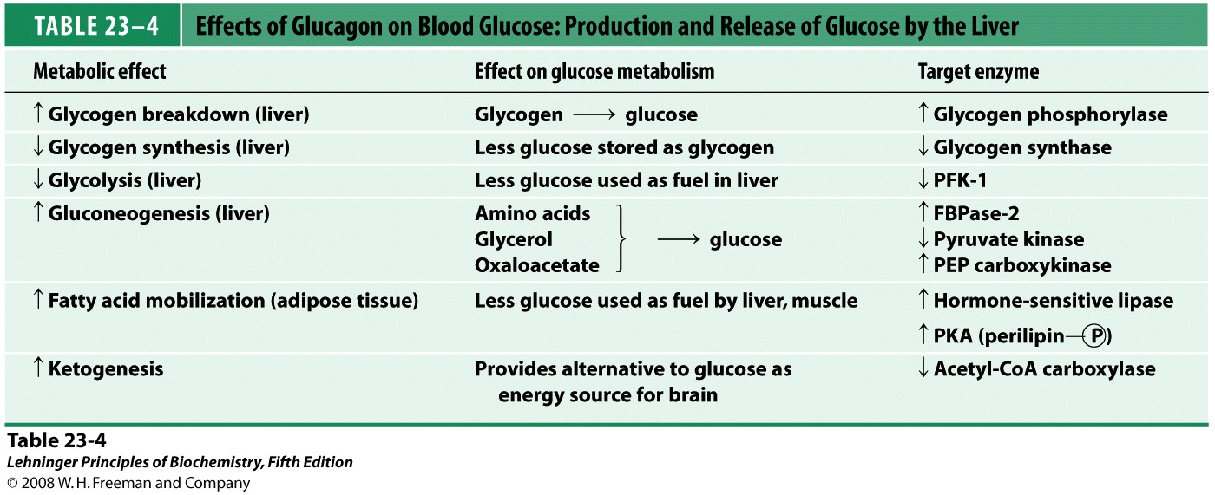
*****
Notes:
TABLE 23-4 Effects of Glucagon on Blood Glucose: Production and Release of Glucose by the Liver

Slide 53
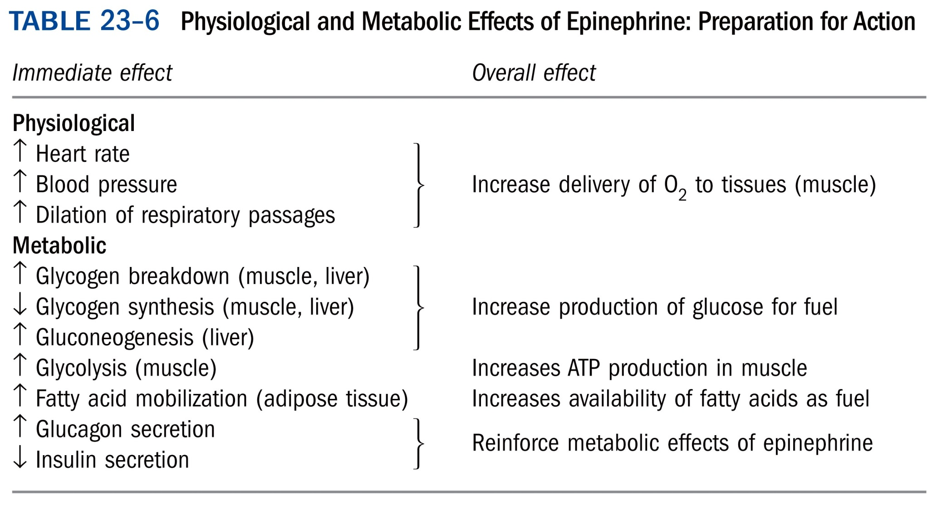
*****

Slide 54
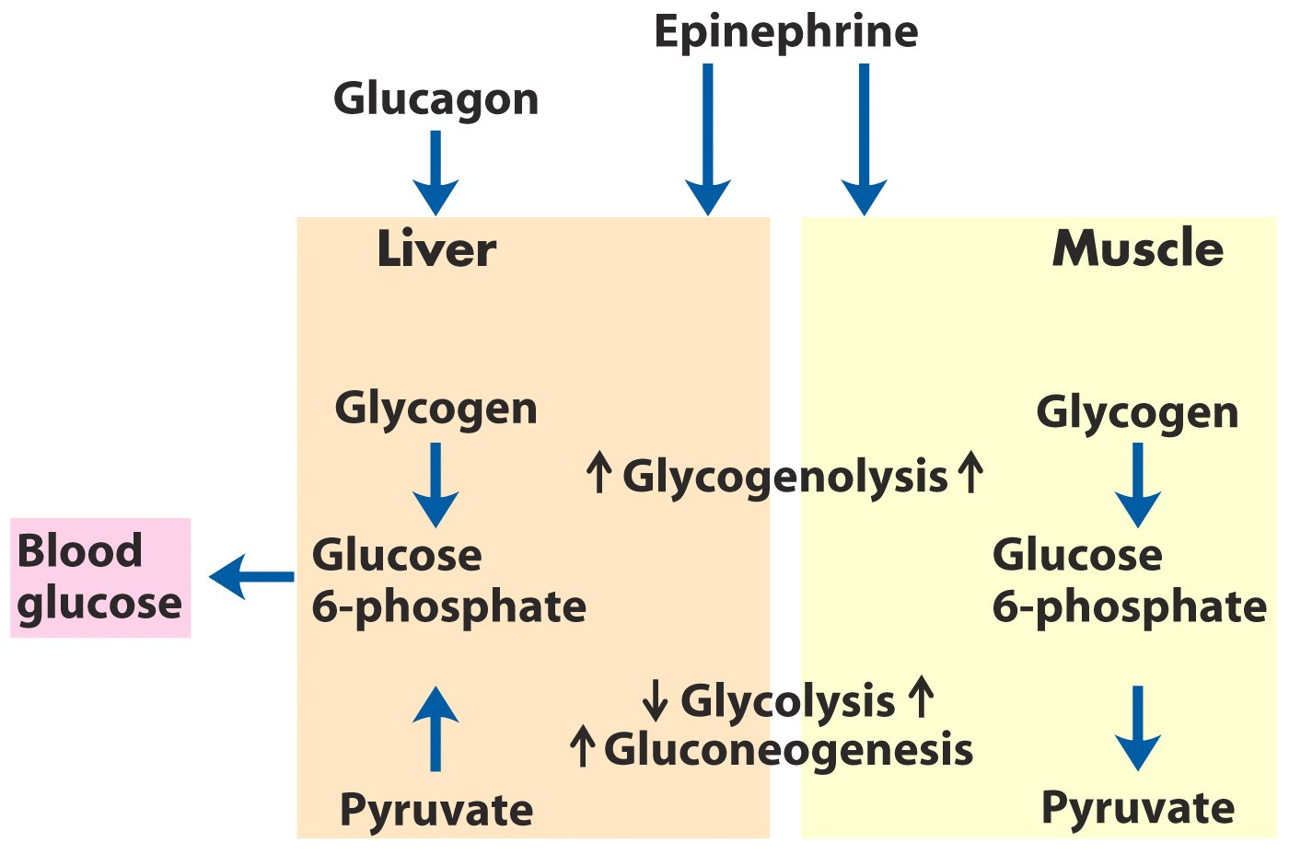
Difference in the regulation of carbohydrate
metabolism in liver and muscle*****

Slide 55
Three types of fuel reserves of a normal human being
Glycogen stored in the liver and muscle
Triacylglycerols stored in adipose tissues
Tissue proteins

Slide 56
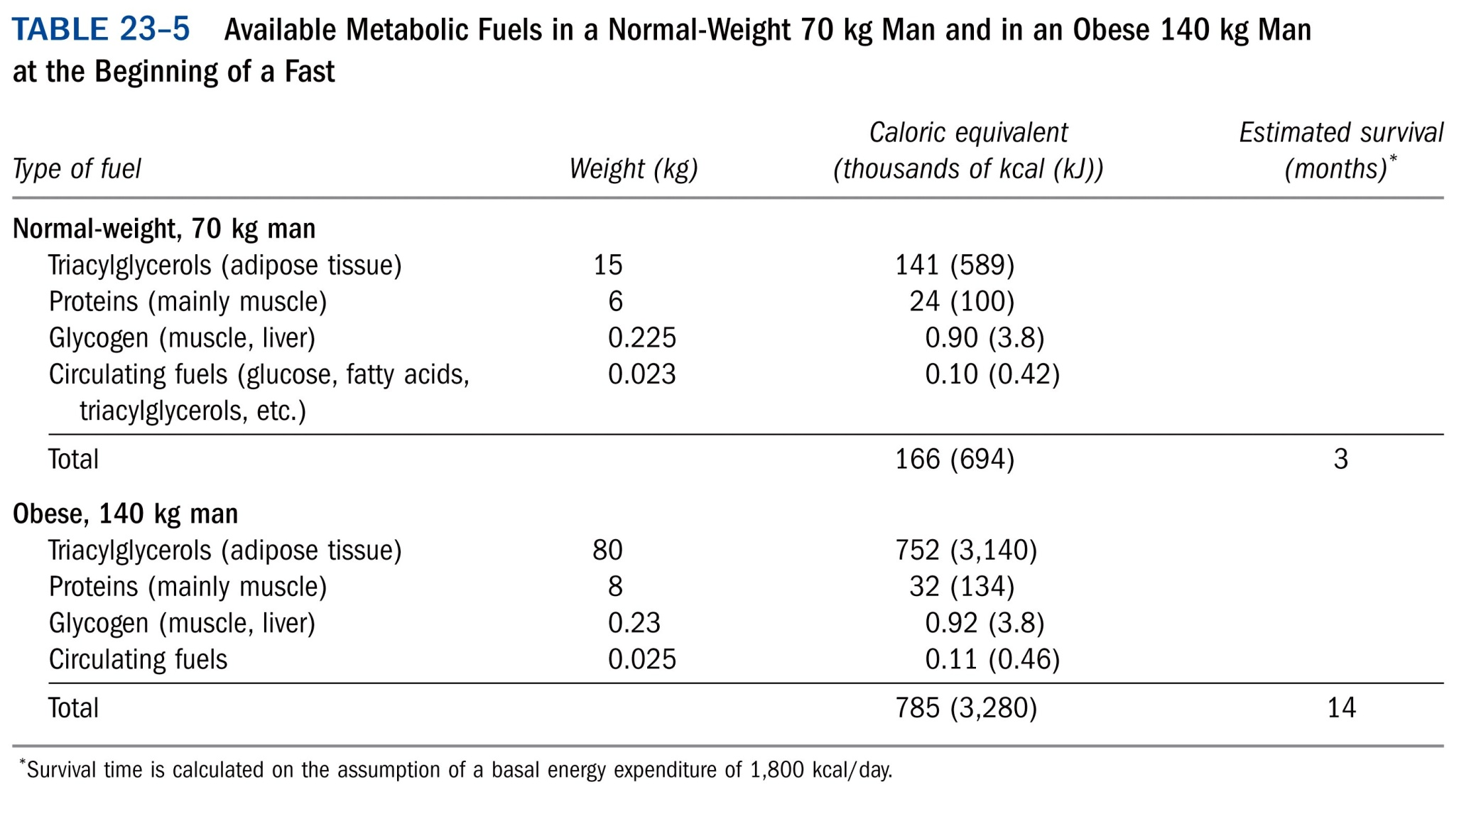

Slide 57
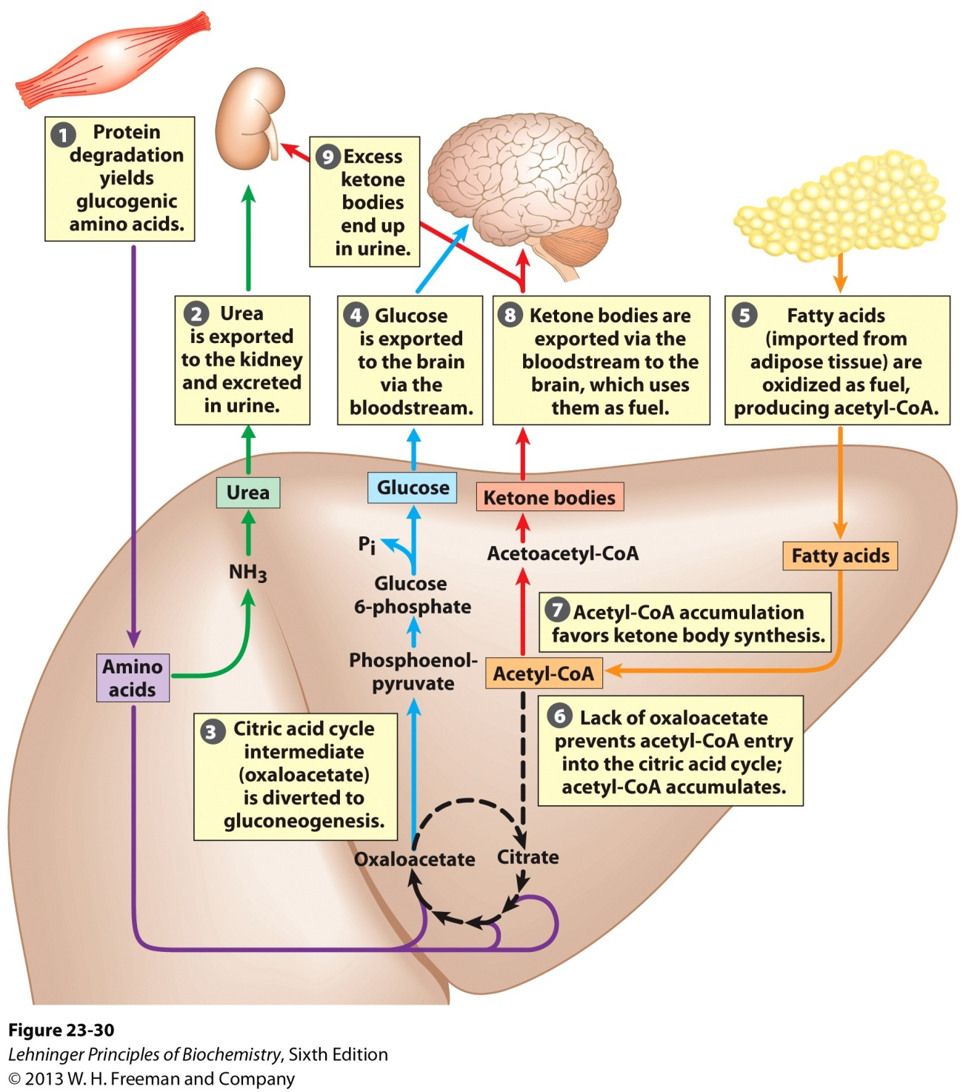
Fuel metabolism in the liver during prolonged fasting
and in uncontrolled diabetes mellitus

Slide 58
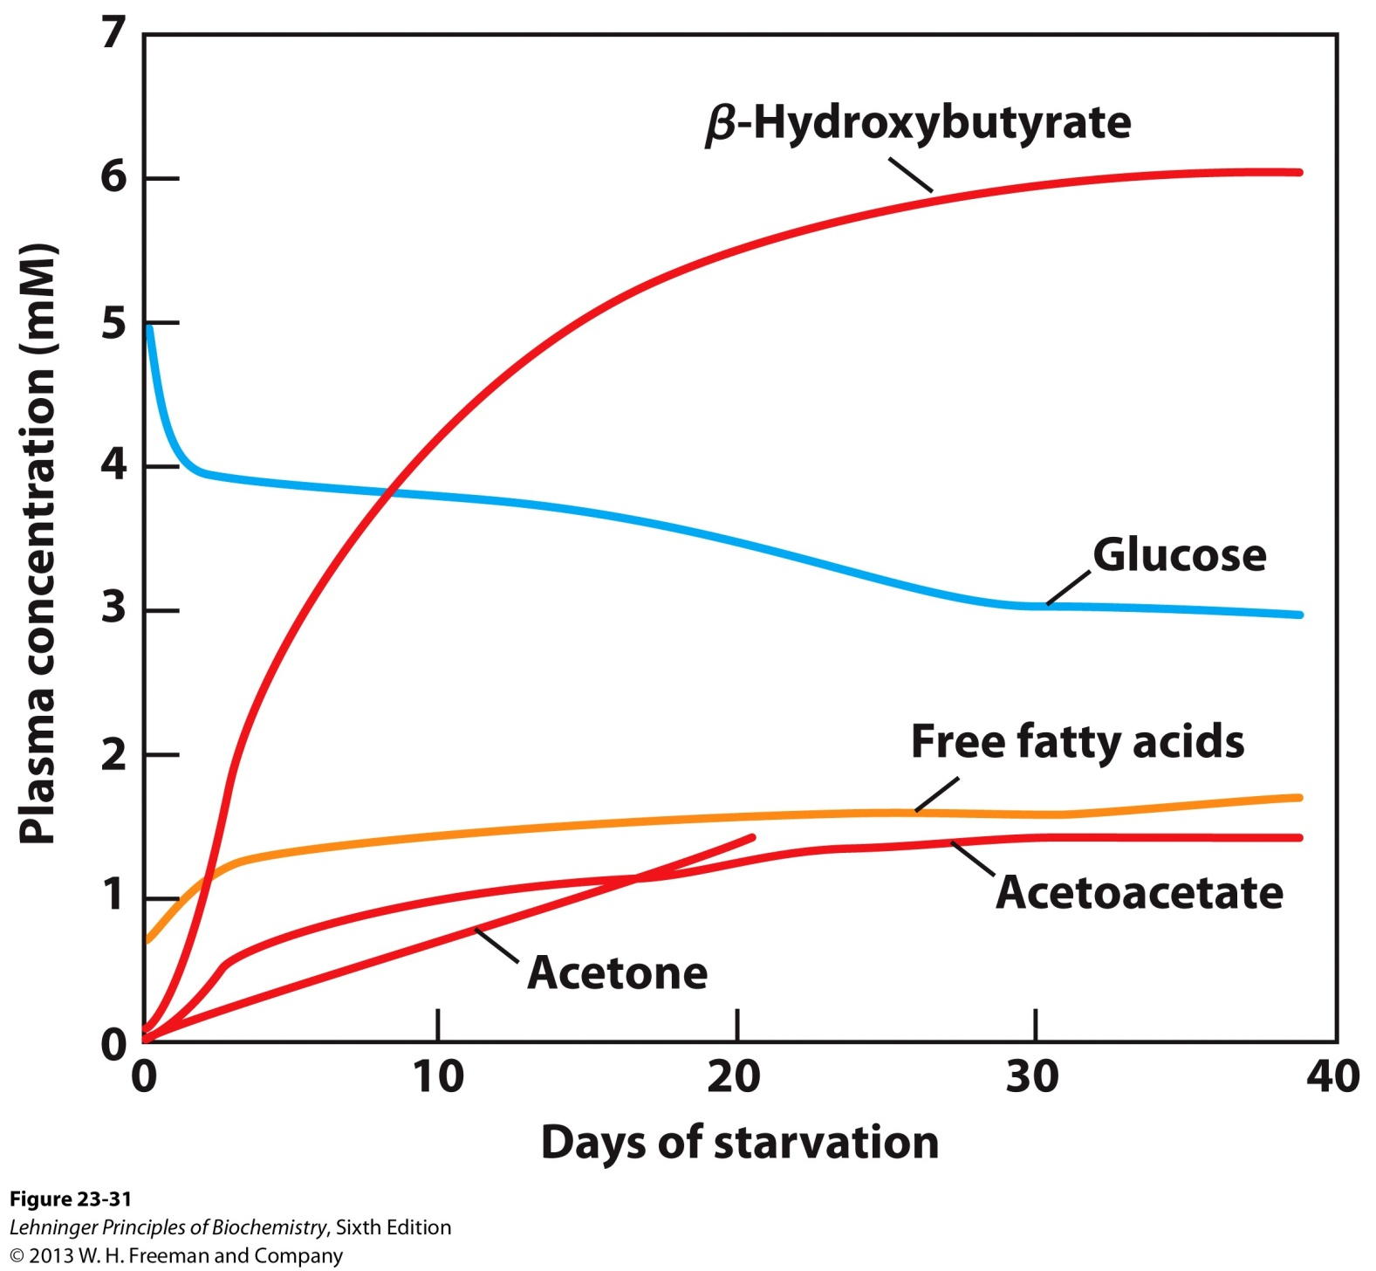
Plasma concentrations of fatty acids, glucose and ketone bodies during six weeks of starvation

Slide 59
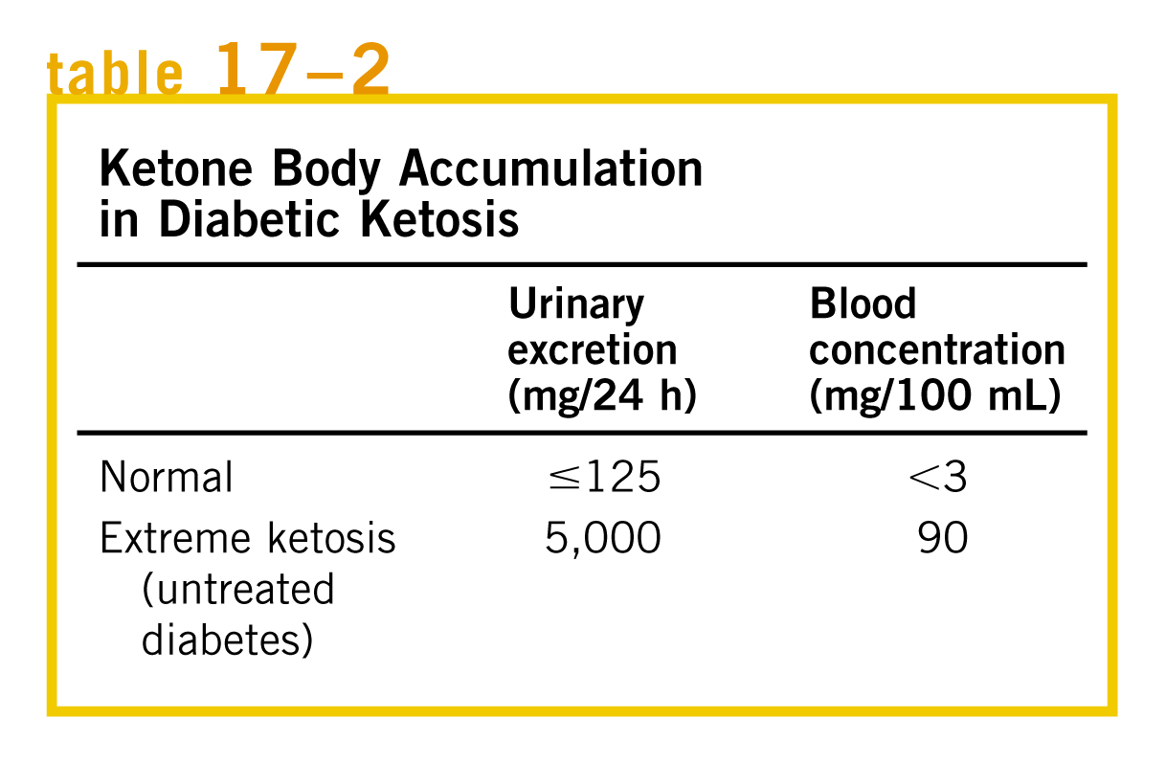
Overproduction of ketone bodies in uncontrolled diabetes or severely reduced calorie intake can
lead to acidosis and ketosis---ketoacidosis.

Slide 60
Ketosis
A medical condition characterized by elevated levels of ketone bodies in blood and urine
Can cause a lowering of blood pH---ketoacidosis (糖尿病酮症酸中毒)
Low-carbohydrate, low-fat diets lead to ketosis
Nutritionists recommend that individuals on low-carbohydrate diets should eat high levels of protein, low carbohydrate, and low fat; consumes large quantities of water, and supplement their diet with vitamins and salt.

Slide 61
Two major clinical classes of diabetes mellitus
Type 1: insufficient production of insulin
usually due to autoimmune destruction of β cells
usually develops early in life
used to be called insulin-dependent or juvenile diabetes
Type 2: insulin resistance
usually develops in late adulthood
usually associated with obesity
cells don’t respond appropriately to insulin

Slide 62
Type 1 diabetes
Results from autoimmune destruction of pancreatic β cells, leading to insufficient production of insulin
The risk is strongly influenced by multiple genetic loci and environment factors
Inheritable, first-degree relatives of patients being at 15-fold greater risk for developing the disease than the general population

Slide 63
Type 2 diabetes
Both genetic and environmental factors account for the epidemic increase in the rate of the disease
Involves both insulin resistance and relative insulin deficiency.
No single gene or protein appears to be causative in the development of the disease (NR4A3, NR4A1, InsP7, EXT2, LOC387761, CDKAL1, CDKN2A/B, IGF2BP2, SLC30A8, and HHEX/IDE, etc)
Heterogeneous, therefore, multiple defects are necessary and permissive to the development of hyperglycemia.
High levels of free fatty acids in the blood interfere with glucose utilization and promote the insulin resistance that leads to type 2 diabetes.

Slide 64
The “lipid toxicity” hypothesis to explain the path from obesity to type 2 diabetes
80% of type 2 diabetics are obese.
Adipocytes become packed and unable to accommodate more TAG.
The inability to deposit TAG leads to fatty acids in the blood.
Excess fatty acids enter muscle and the liver, create TAG lipid droplets, and cause these organs to lose sensitivity to insulin.
Ultimately, blood glucose levels rise.

Slide 65
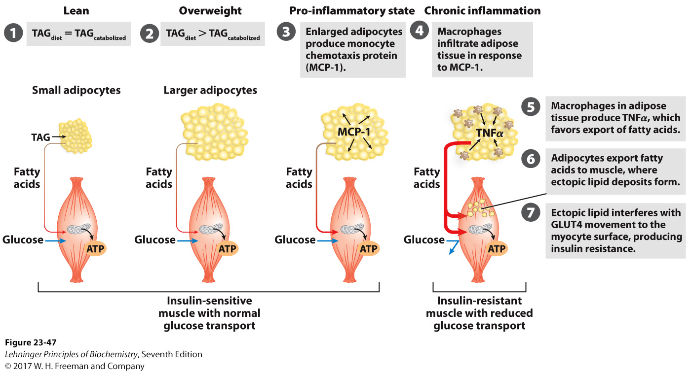
Overloading adipocytes with triacylglycerols
triggers inflammation in fat tissue and ectopic
lipid deposition and insulin resistance in muscle.
Notes:
FIGURE 23-47 Overloading adipocytes with triacylglycerols triggers inflammation in fat tissue and ectopic lipid deposition and insulin resistance in muscle. In an individual of healthy body mass, triacylglycerol (TAG) uptake in the diet equals TAG oxidation for energy. In overweight individuals, excess caloric intake results in enlarged adipocytes, engorged with TAG and unable to store more. Enlarged adipocytes secrete MCP-1 (monocyte chemotaxis protein-1), attracting macrophages. Macrophages infiltrate adipose tissue and produce TNF α (tumor necrosis factor α), which triggers lipid breakdown and fatty acid release into the blood. The fatty acids released from adipose tissue enter muscle cells, where they accumulate in small lipid droplets. This ectopic storage of lipids somehow causes insulin resistance, perhaps by triggering lipid-activated protein kinases that inactivate some element in the insulin-signaling pathway. GLUT4 glucose transporters leave the muscle cell surface, preventing glucose entry into muscle; the myocyte has now become insulin-resistant. It cannot use blood glucose for its fuel, so fatty acids are mobilized from adipose tissue and become the primary fuel. The increased influx of fatty acids into muscle leads to further deposition of ectopic lipids. In some individuals, insulin resistance develops into type 2 diabetes. Other individuals are genetically less susceptible to the deleterious effects of ectopic lipid storage or are genetically better equipped to manage this storage and do not develop diabetes.

Slide 66
Symptoms of diabetes
Frequent hunger, especially pronounced hunger
Frequent thirst, especially excessive thirst
Frequent urination, especially excessive urination
Blurred vision
Fatigue
Weight loss
Poor wound healing (cuts, scrapes, etc.)
Dry mouth
Dry or itchy skin
impotence (male)
Recurrent infections
Deep, rapid breathing
Cardiac arrhythmia 心律失常
ketoacidosis (diabetic coma)

Slide 67
Diabetes arises from defects in insulin production or action
Diabetes patients, due to lack of insulin, not only are unable to use glucose properly, but also fail to synthesize fatty acids from carbohydrates or amino acids.
Increased rates of fatty acid oxidation and ketone body formation,
Excretion of large amounts of glucose in the urine
Glucose-tolerance test for diagnosis

Slide 68
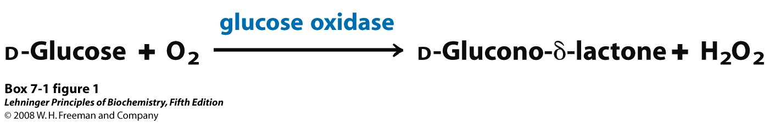
The glucose oxidase reaction, used in the
measurement of blood glucose
Notes:
BOX 7-1 FIGURE 1 The glucose oxidase reaction, used in the measurement of blood glucose. A second enzyme, a peroxidase, catalyzes the reaction of the H₂O₂ with a colorless compound to produce a colored product, which is measured spectrophotometrically.

Slide 69
Elevated blood glucose can have serious physiological consequences
High levels of glucose (hyperglycemia) are believed to be at least one cause of the serious long-term consequences of untreated diabetes
* kidney failure
* cardiovascular disease
* blindness
* impaired wound healing
* heart attack, stroke, heart failure
* neuropathy (loss of sensation, especially in the feet)

Slide 70
The average blood glucose concentration can be assessed by the amount of glycated hemoglobin
Glycated hemoglobin (GHB, 糖化血红蛋白, hemoglobin A1c, Hb1c , or HbA1c, A1C) is a form of hemoglobin used primarily to identify the average blood glucose concentration over prolonged periods of time.
Normal : GHB --- 5% of total hemoglobin,
glucose --- 120mg/100ml
Untreated diabetes: 13%, 300mg/100ml
After insulin therapy: 7%

Slide 71
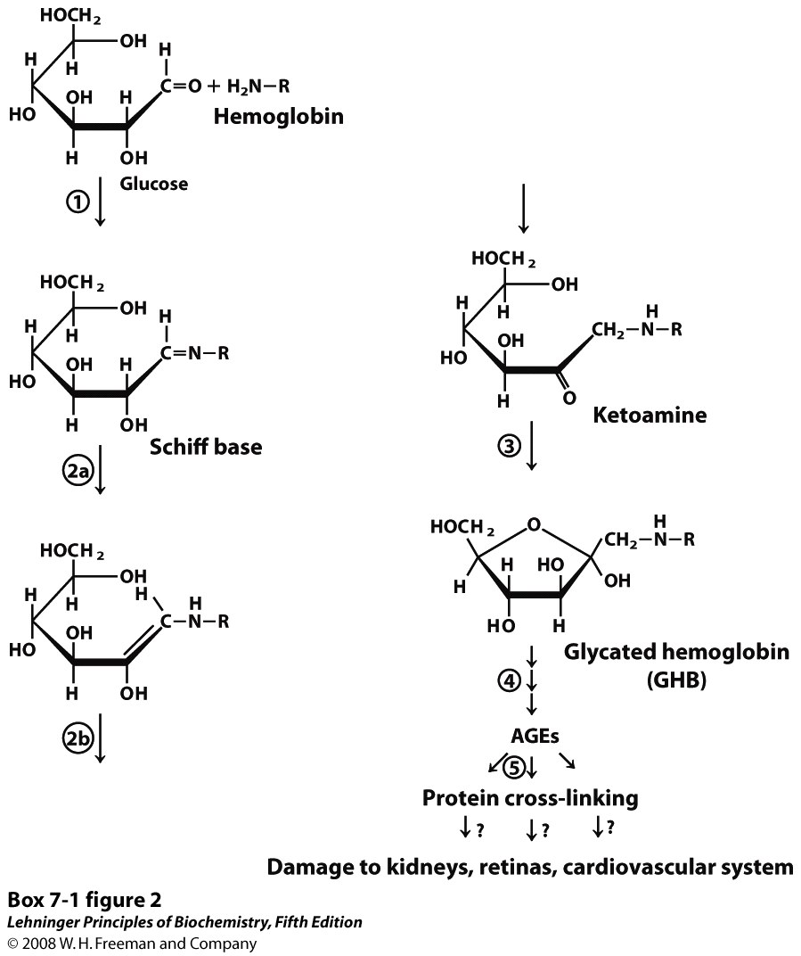
Advanced glycation end products
Notes:
BOX 7-1 FIGURE 2 The nonenzymatic reaction of glucose with a primary amino group in hemoglobin begins with (1) formation of a Schiff base, which (2) undergoes the Amadori rearrangement to generate a stable product; (3) this ketoamine can further cyclize to yield GHB. (4) Subsequent reactions generate advanced glycation end products (AGEs), such as ε-N-carboxymethyllysine and methylglyoxal, compounds that (5) can damage other proteins by cross-linking them, causing pathological changes.

Slide 72
Some bad habits that might lead to type 2 diabetes
Eat too much snacks (零食)
No or little carbohydrates in diet
No physical exercises
Too stressed
Not enough sleep

Slide 73
Treatments for Type 2 diabetes
Diet and exercise to reduce obesity, manage blood glucose, increase insulin sensitivity of muscles
Insulin, if endogenous insulin secretion is inadequate
AMPK activator: Metformin (glucophage)
PPARγ activators to increase adiponectin, stimulate adipocyte differentiation, and increase capacity for TAG storage: thiozidinediones
Stimulation of insulin secretion by binding to ATP-gated K⁺ channels: sulfonylureas
Preventing proteolytic degradation of glucagon-like peptide-1 (GLP-1), a peptide that stimulates insulin secretion (dipeptidyl protease-4 inhibitors, such as Januvia)

Slide 74
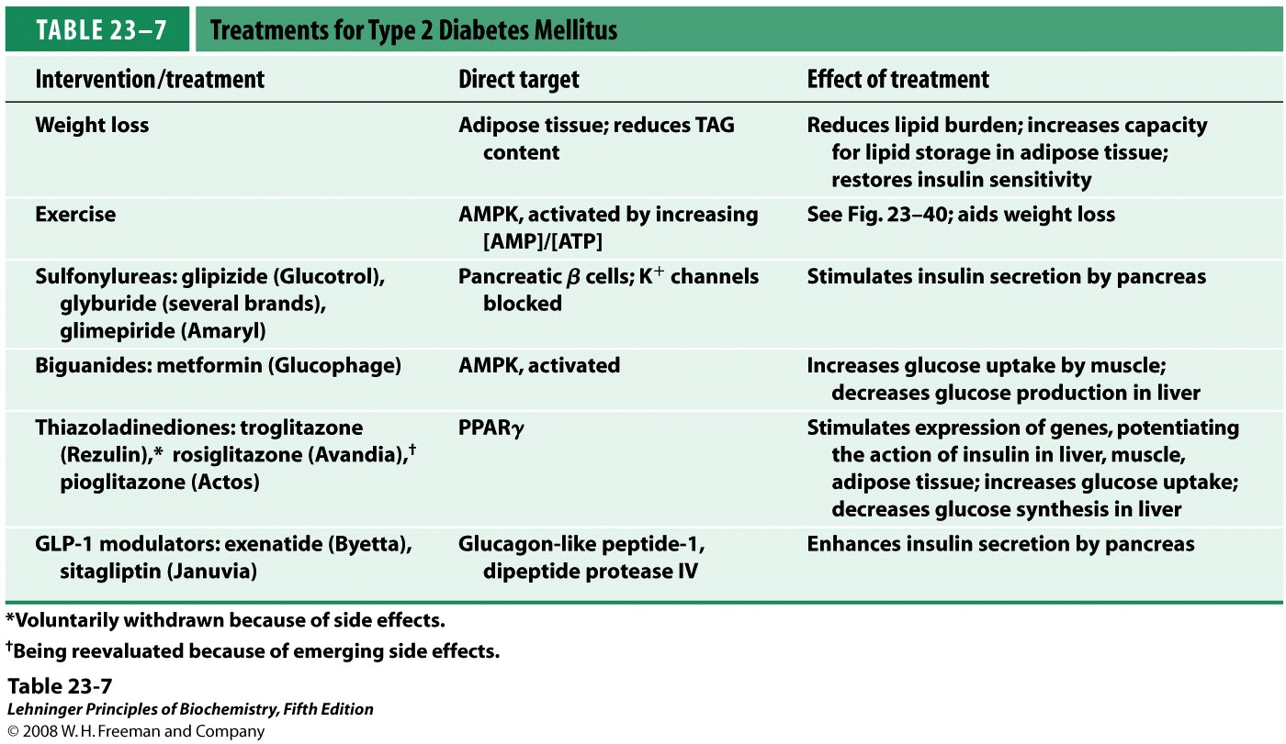
insulin sensitizer 胰岛素增敏剂
Aim is to prevent long-term complications
Notes:
TABLE 23-7 Treatments for Type 2 Diabetes Mellitus

Slide 75
Hormones act through specific high-affinity cellular receptors
Cell-surface receptor for peptide and amine hormones (water-soluble)---fast-acting
Nuclear receptor for steroid, retinoid and thyroid hormones (water-insoluble)---slow-acting

Slide 76
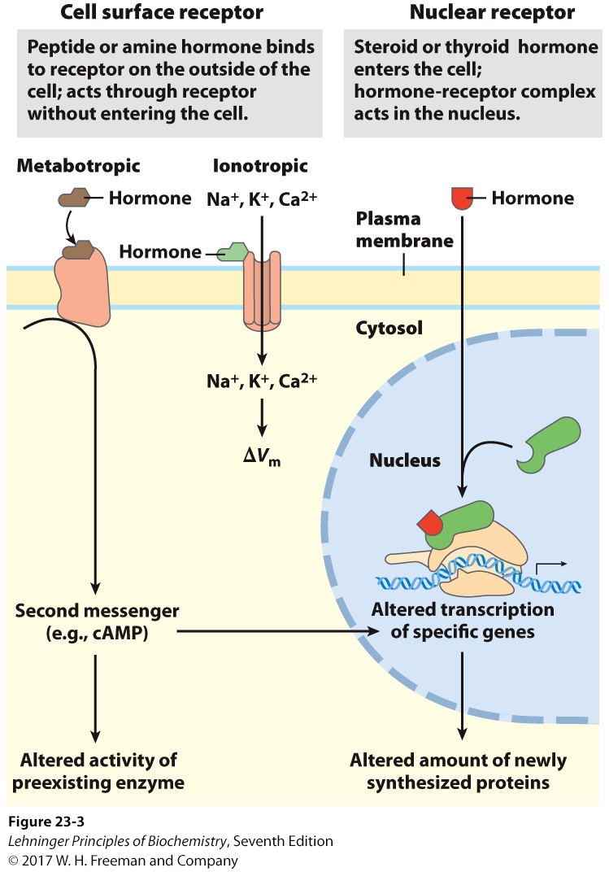
Two general mechanisms
of hormone action

Slide 77
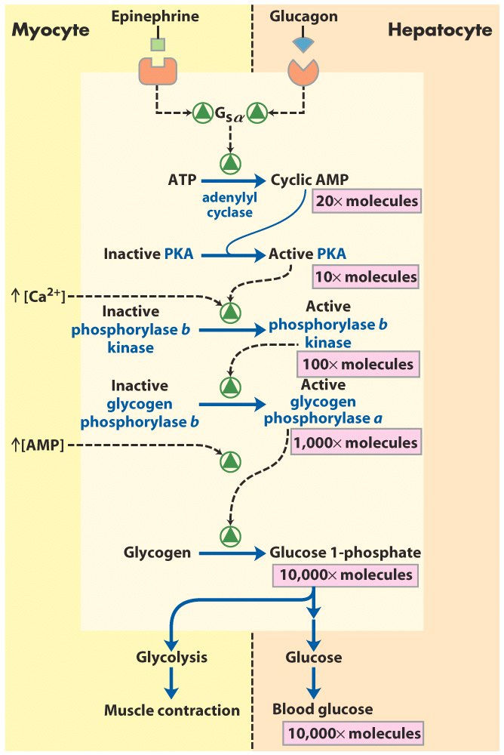
The receptor serves
not only as a signal
transducer, but also
as a signal amplifier.

Slide 78


Slide 79
What regulates the level of each hormone
The central nervous system receives input from many internal and external sensors and orchestrates the production of appropriate hormonal signals by the endocrine tissues of the body.

Slide 80

(coordination center)
下丘脑
垂体
The major endocrine glands

Slide 81

Location of the hypothalamus and pituitary gland

Slide 82

The major endocrine systems and their target tissues

Slide 83

The hypothalamus-pituitary system

Slide 84

Cascade of hormone
release following
central nervous system
input to the hypothalamus:
the cascade is sensitive to
regulation at several levels
through feedback inhibition
by the ultimate hormone.

Slide 85


Slide 86


Slide 87

Acetylated metabolic enzymes identified by
proteomic survey (marked in red)

Slide 88
Why are so many enzymes in a given pathway acetylated
Most metabolic pathways are not linear; rather, they form a network with many branches from each pathway sharing common intermediates. Therefore, acetylation of multiple enzymes might provide a mechanism of coordinating different pathways.

Slide 89
The concentration of acetyl-CoA globally influence the acetylation level of metabolic enzymes
Acetyl-CoA is a key intermediate metabolite produced and consumed by many metabolic reactions; as such, its cellular concentration is linked to many metabolic pathways. Thus, any alterations in its concentration might modify and regulate metabolic pathways in response to both extracellular and intracellular metabolic status.

Slide 90


Slide 91


Slide 92


Slide 93


Slide 94


Slide 95
Keywords
Integration of metabolism---function of liver and adipose tissue
Hormonal regulation---epinephrine, glucagon and insulin

Slide 96
Words of the week
epinephrine, glucagon and insulin
hyperglycemia 高血糖
hypoglycemia 低血糖

Slide 97
Text-book reading of the week
Summary 23.1 (p937)
Summary 23.2 (p950)
Summary 23.3 (p960)
p951-960 (Hormonal regulation of fuel metabolism)
p288-290 (Guide book)

Slide 98
Important pictures
22-4
14-4
22-11
14-21
16-22
22-37
22-38
19-16
22-48
19-19
22-49
19-31
19-32
19-65
Guide Book: p289-290
14-17

Slide 99
Something you should know for Part II
Major catabolic and anabolic pathways, including:
the mechanism of important reactions
the enzymes or coenzymes involved
regulation of the pathway
interconnection with the other pathways

